Slide 1
Presentation Instructions
The presentation should be 5-8 minutes long and use a maximum of 6 slides
Both group members must speak during the presentation
The presentation will be evaluated using the “Oral Communication Value Rubric,” which will be provided to you. Look over it closely to make sure you are meeting expectations.
The following example and template are here to help get you started.
You can follow the tempate exactly or deviate from it slightly, i.e. change the fonts and adjust the layout.

Slide 2
Example: Title page
2016 Election &
Anti-Semitism:
The Clinton Meme

Slide 3
Example: Close up of image
Using Symbols: Star of David
Bullet Point 1
Bullet Point 2
Bullet Point 3
Bullet Point 4

Slide 4
Example: Close up of image & comparison
Using Symbols: Star of David
Bullet Point 1
Bullet Point 2
Bullet Point 3
Bullet Point 4

Slide 5
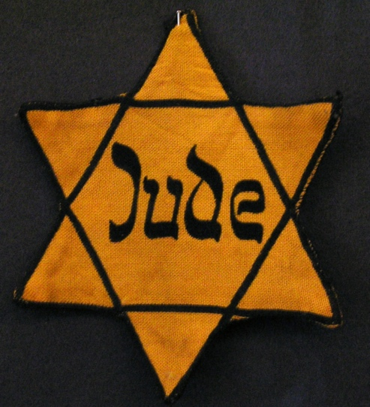
Image comparison example
Example: Close up of image & comparison
The Act of “Marking” Jews
Bullet Point 1
Bullet Point 2
Bullet Point 3
Bullet Point 4

Slide 6
Example: Close up of image
The Money Stereotype
Bullet Point 1
Bullet Point 2
Bullet Point 3
Bullet Point 4

Slide 7
The image you are working with:
Note the sender is David Duke and the image is of George Soros.

Slide 8
Presentation Title
[Your Presentation template begins here-Delete this text]
(Insert image)
Student names & Student Name

Slide 9
Header/Title
Bullet Point 1
Bullet Point 2
Bullet Point 3
Bullet Point 4
(Insert image)

Slide 10
Header/Title
Bullet Point 1
Bullet Point 2
Bullet Point 3
Bullet Point 4
(Insert image)

Slide 11
Header/Title
Bullet Point 1
Bullet Point 2
Bullet Point 3
Bullet Point 4
(Insert image)

Slide 12
Header/Title
Bullet Point 1
Bullet Point 2
Bullet Point 3
Bullet Point 4
(Insert image)

Slide 13
Header/Title
Bullet Point 1
Bullet Point 2
Bullet Point 3
Bullet Point 4
(Insert image)

