Slide 1
Activity 5: Critically Reading the Author Index Student Learning Objective: The student will apply practical critical reading skills in order identify key contributors and writings in the psychology discipline.
ACRL Framework 6. Searching as Strategic Exploration
6.3 Utilize divergent and convergent thinking when searching.
6.4 Match information needs and search strategies to search tools.
6.5 Design and refine needs and search strategies, based on search results.
APA Guidelines
2.2c Identify and navigate psychology databases and other legitimate sources of psychology information.
Critical reading pedagogy: paradigmatic text, lists, numbers.

Slide 2
Tools for Instruction
Searching in the author field for Gourash, Nancy = 1 result.
A key word search for Gourash Nancy = 4 results.
Reading the citations closely, one sees that her married name is Bliwise.

Slide 3
Tools for Instruction
A search in the Author Index for Bliwise, Nancy = 20 total results.
Her name is listed 3 different ways:
Bliwise, Nancy
Bliwise, Nancy G.
Bliwise, Nancy Gourash
Also listed as:
Gourash, Nancy

Slide 4
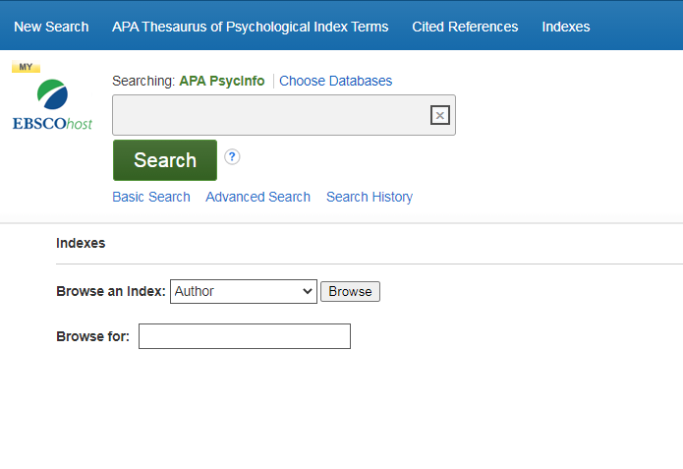
Using the Author Index, find all of the articles listed in PsycInfo by this person:
B.F. Skinner
Hint: His full name is Burrhus Frederic
There is also an error in the database relating to this name. Can your identify the error?
Learning Activity

