Slide 1
Activity 7: Critically Reading Help Sheets Student Learning Objective: The student will apply practical critical reading skills to Help Sheets in order to identify methods for searching, identifying, evaluating, and assessing pertinent information sources.
ACRL Framework 6. Searching as strategic exploration
6.4 Match information needs and search strategies to search tools.
6.6 Understand how information systems are organized to access relevant
information.
APA Guidelines
2.2c: Identify and navigate psychology databases and other legitimate sources of psychology information.
Critical reading pedagogy: paradigmatic, unfamiliar vocabulary, library science jargon, codes, fields, tags, abbreviations.

Slide 2
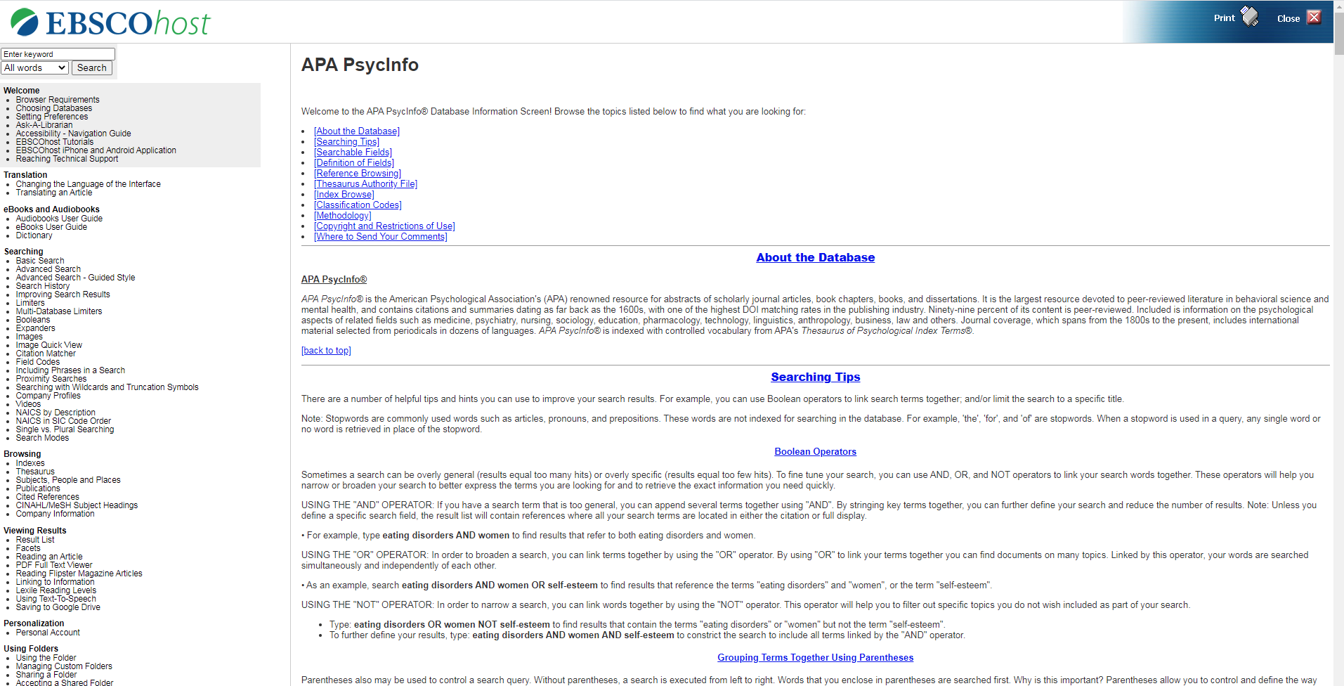
Tools for Instruction
Using the 7 fields needed from Activity 2, identify one to explore in the help sheets. Methodology is a good field to teach because students often need a certain type of study as specified by their professor.

Slide 3
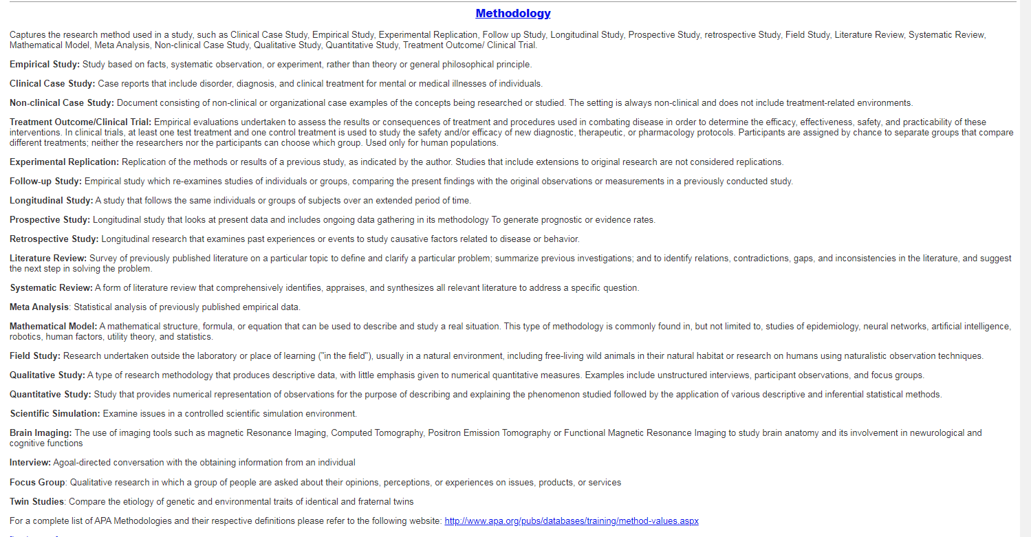
Tools for Instruction

Slide 4
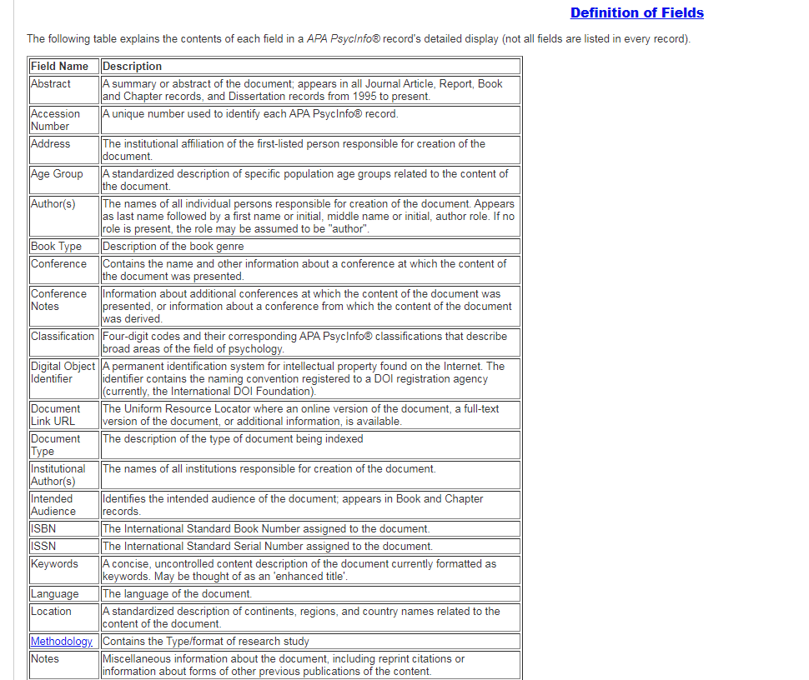
Tools for Instruction

Slide 5
Learning Activity
Activity 1: Students search for a topic (each student selects one topic) and limits to various methodologies.
Remind students that methodologies are listed in the help sheets.
Use the help sheets to define the method.
Questions:
How many results did you get with each different methodology?
Pick a result and define/describe the method used in the study.
Topic | Method
Reproductive technology | Empirical
Risk taking and college students | Quantitative
Body modification | Qualitative
Rock music | Longitudinal
 | Twin studies

Slide 6
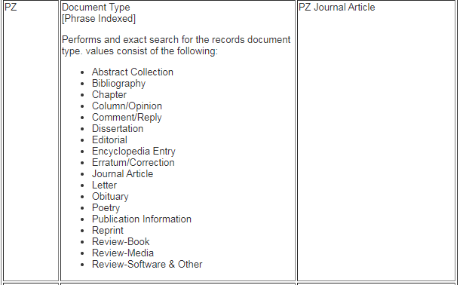
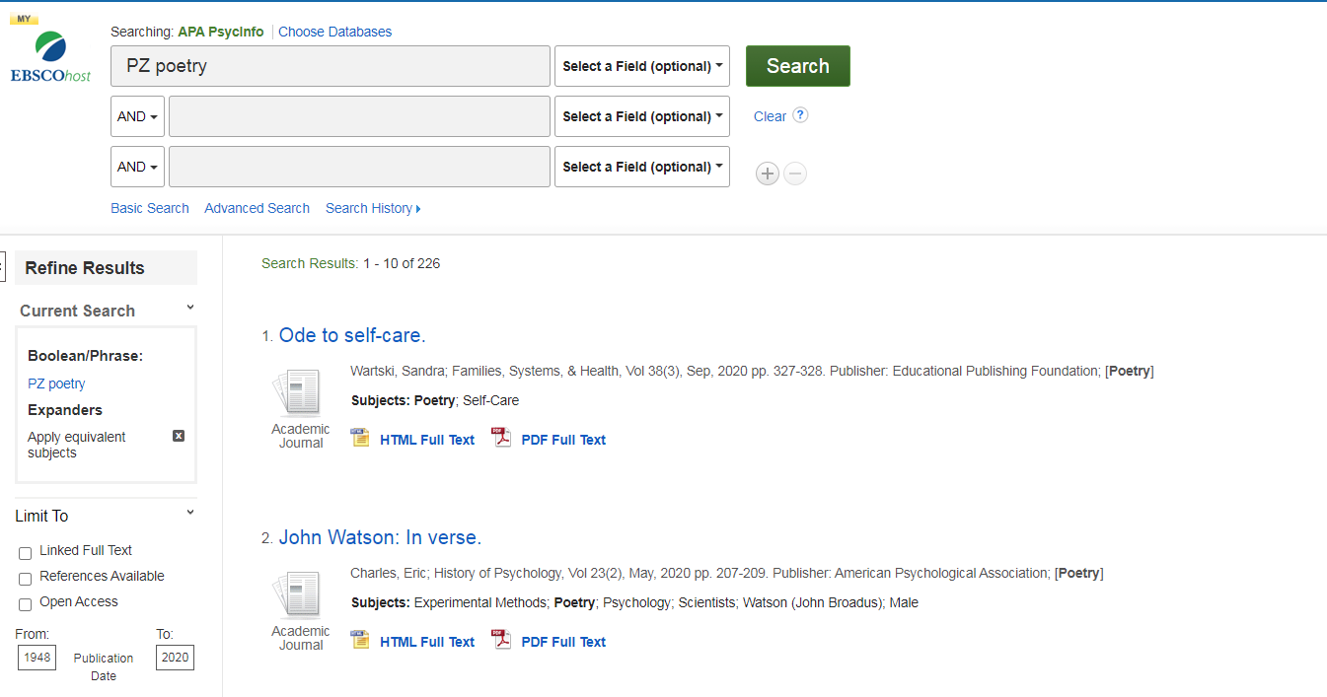
Tools for Instruction
Search Option 1 PZ

Slide 7
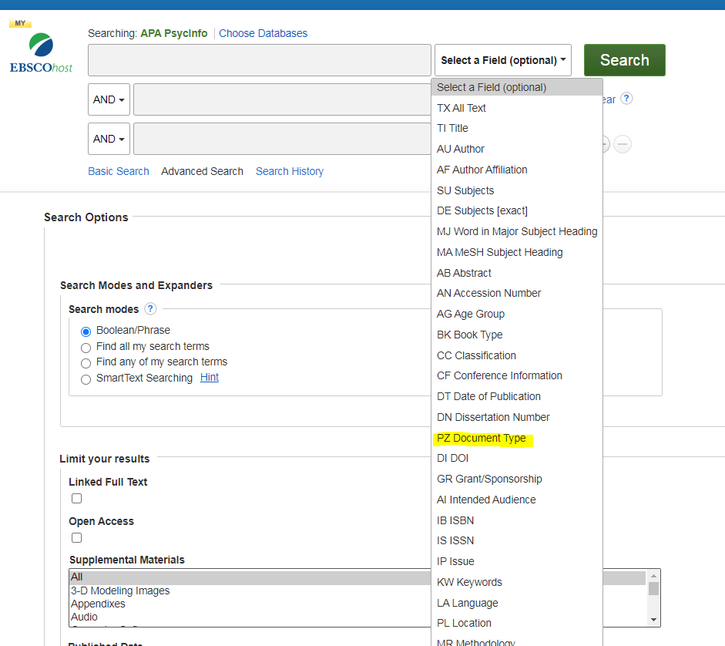
Tools for Instruction
Search Option 2 Select the PZ field.

Slide 8
Learning Activity
Activity 2:
Search for a topic by limiting to the title field and a specific document type.
Remind students that types and definitions are listed in the help sheets.
Questions:
How many results did you get with each different type?
Pick a result and define/describe the type of document found and the source type.
This is a ____________ in a ___________.
This is an obituary in a scholarly journal.
Is it a research study? Yes/No
Topic | Document Type
Sigmund Freud | obituary
pandemic | poetry
Body modification | journal article
Rock music | chapter
Body modification | dissertation

