Slide 1
EPA website

Slide 2
www.epa.gov
October 17, 2017

Slide 3
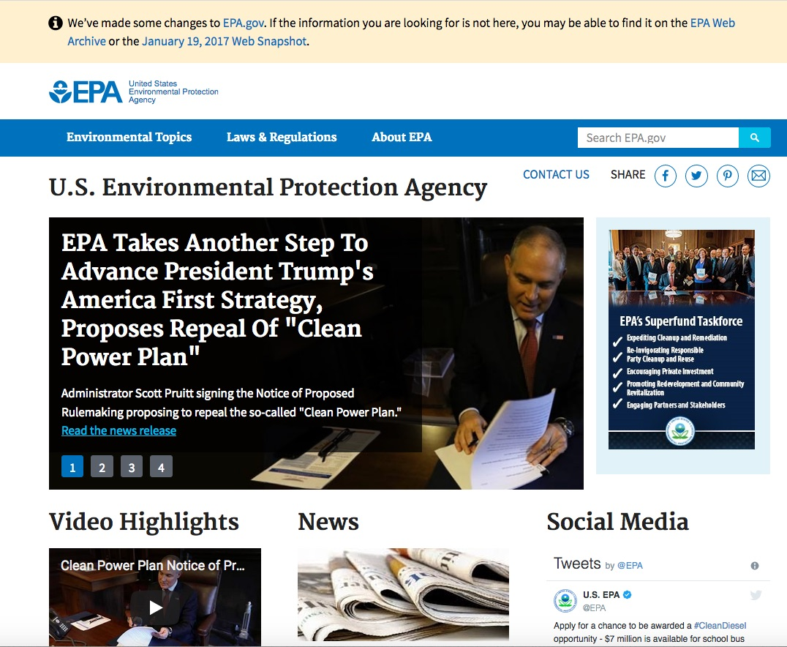
Notes:
https://www.epa.gov/
10/17/2017

Slide 4
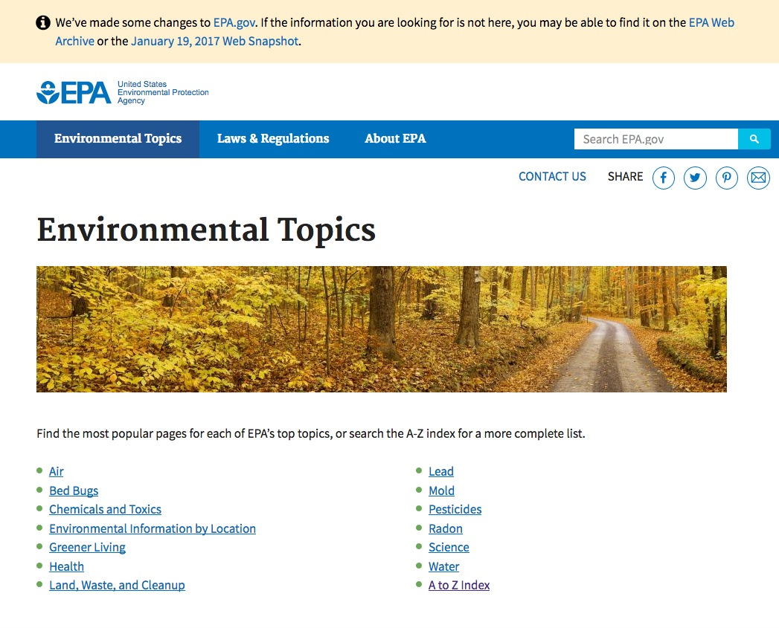
Notes:
https://www.epa.gov/environmental-topics
10/17/2017

Slide 5
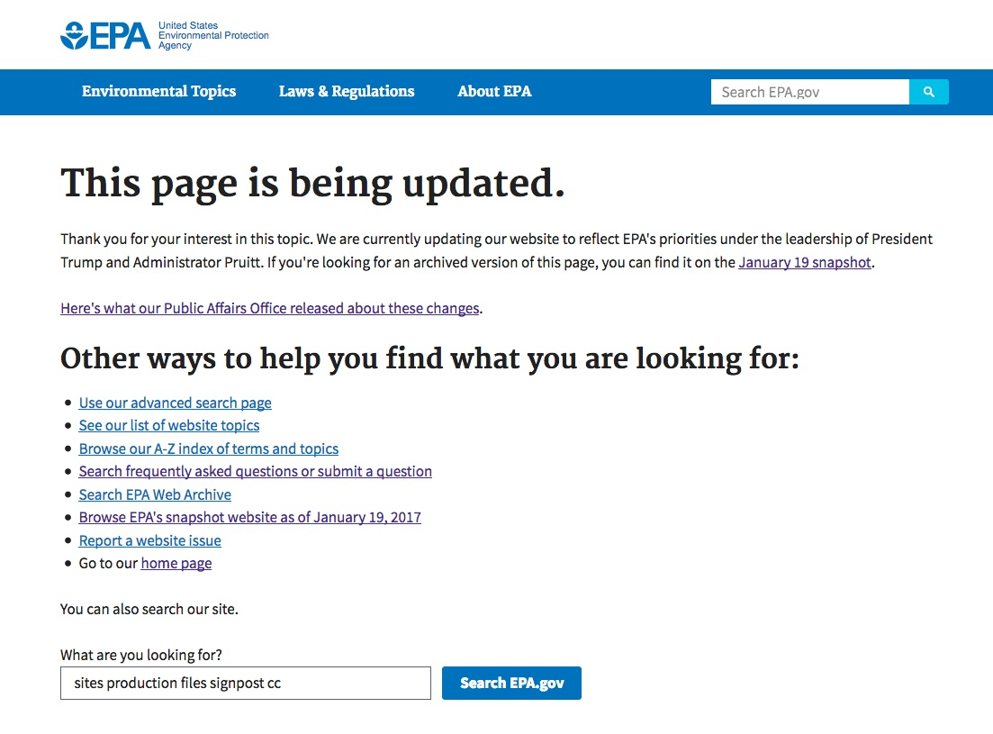

Slide 6
https://19january2017snapshot.epa.gov
January 19, 2017*
Notes:
* As viewed on October 17, 2017

Slide 7
Notes:
https://www.epa.gov/
10/17/2017

Slide 8
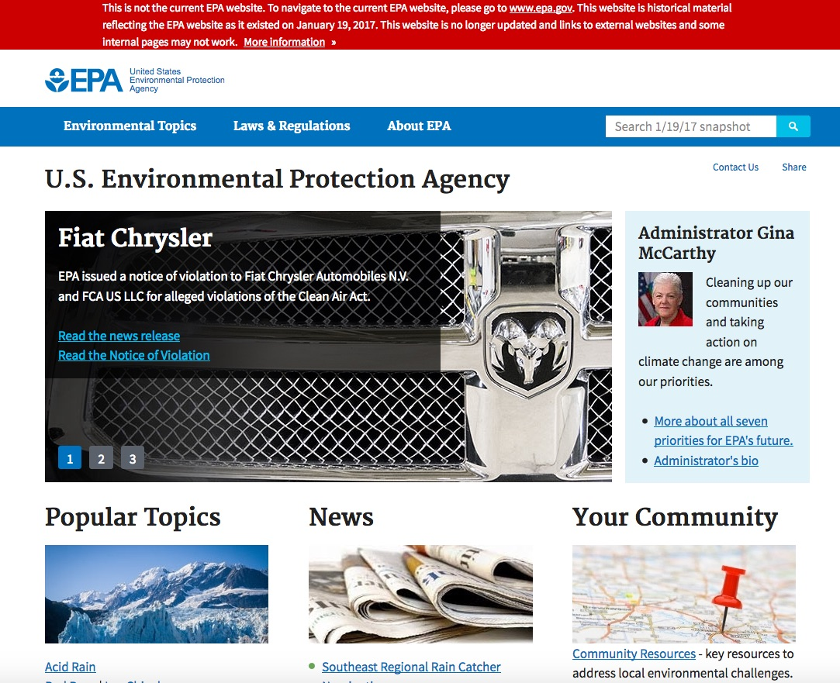
Drop-down menu
Scroll down

Slide 9
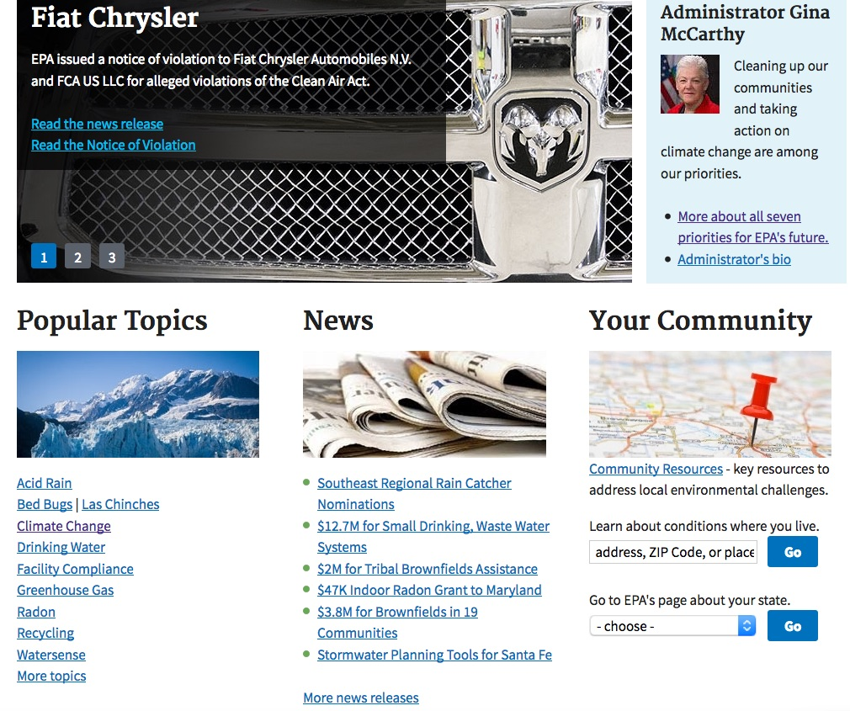

Slide 10
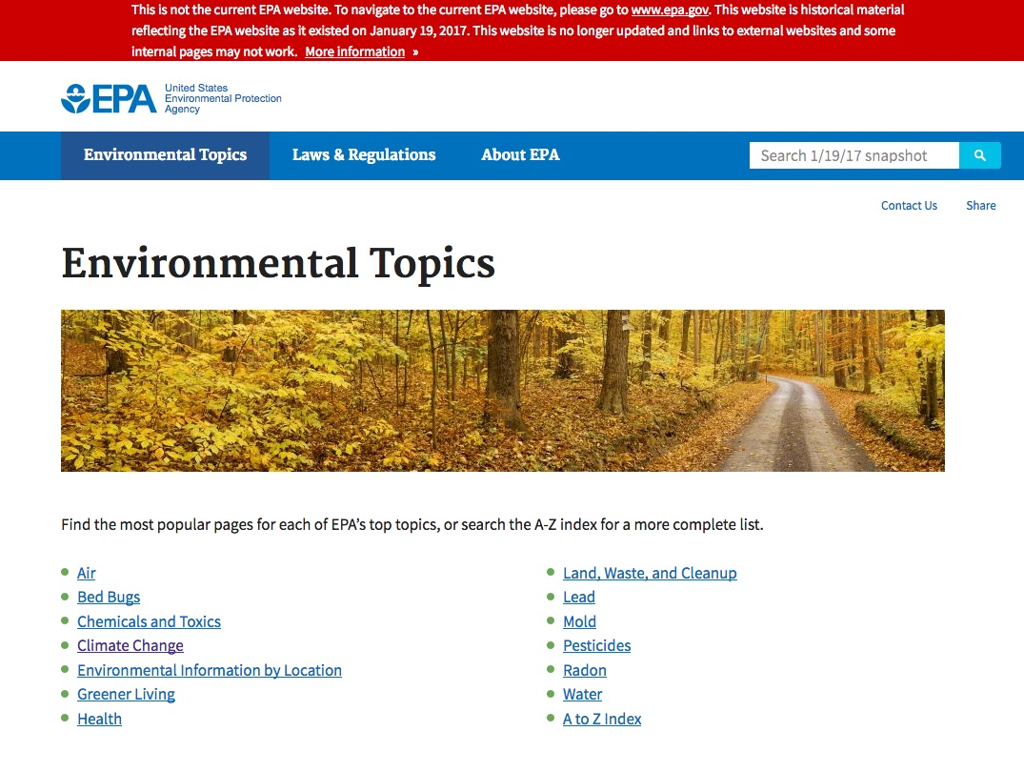

Slide 11
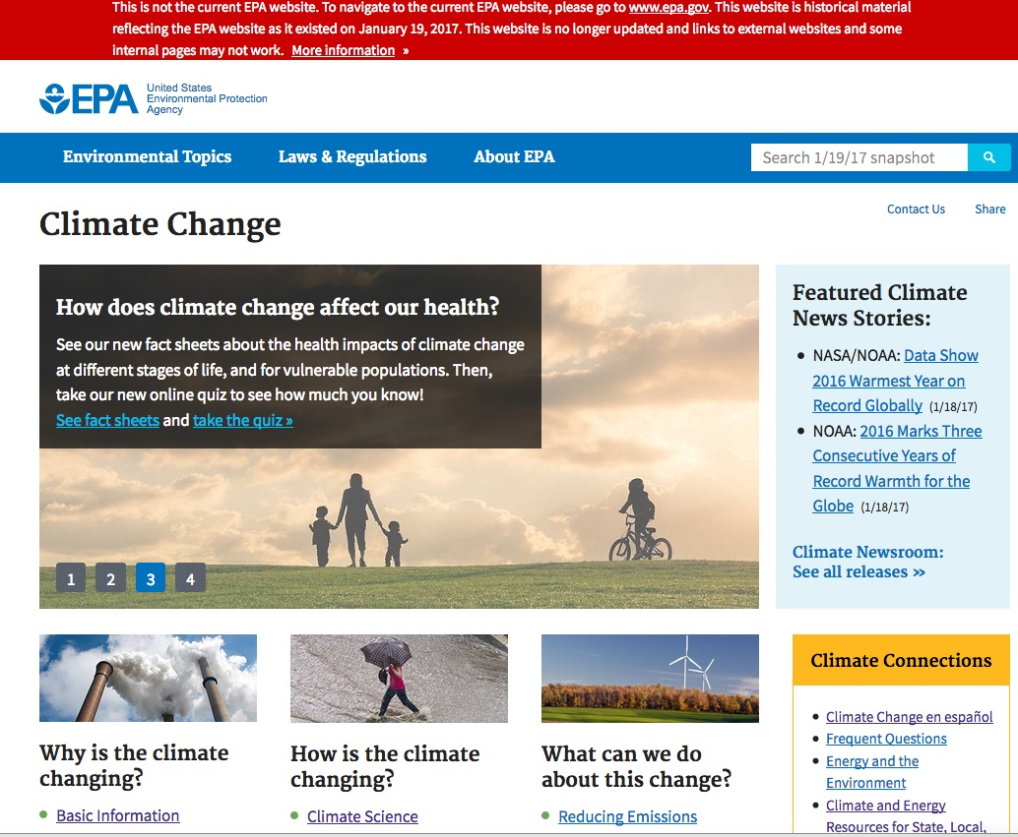

Slide 12
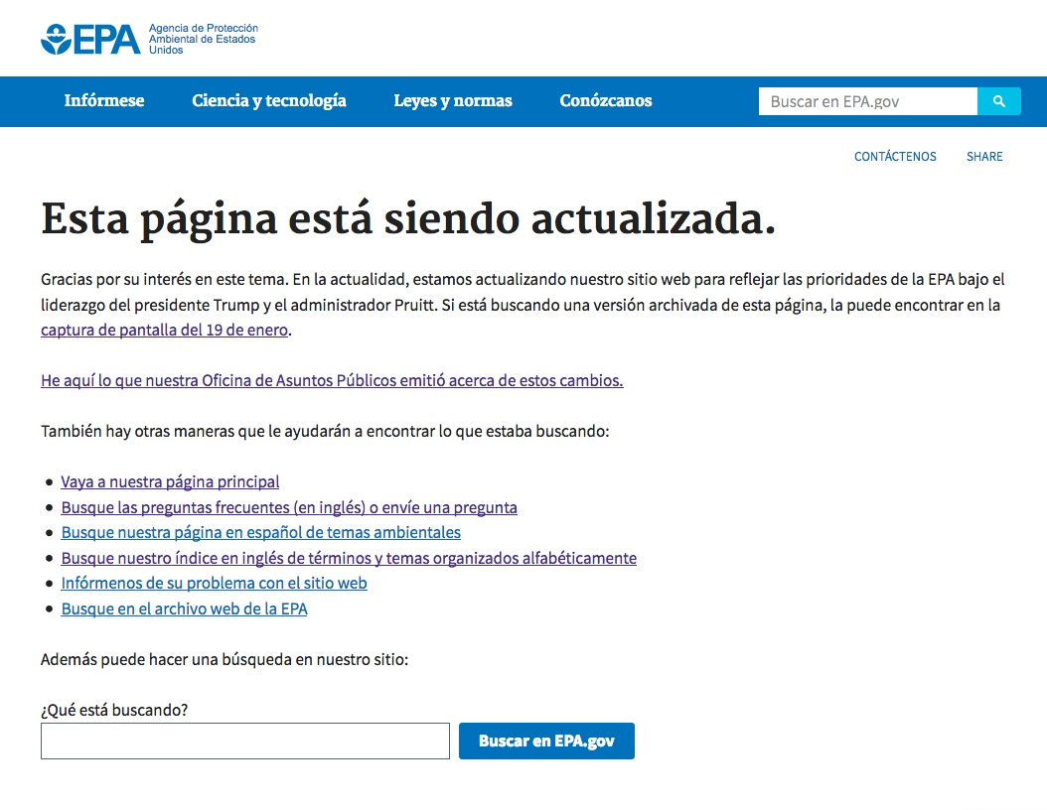

Slide 13
https://web.archive.org/web/20080131061007/http://epa.gov/
January 31, 2008*
Notes:
* As viewed on October 17, 2017

Slide 14
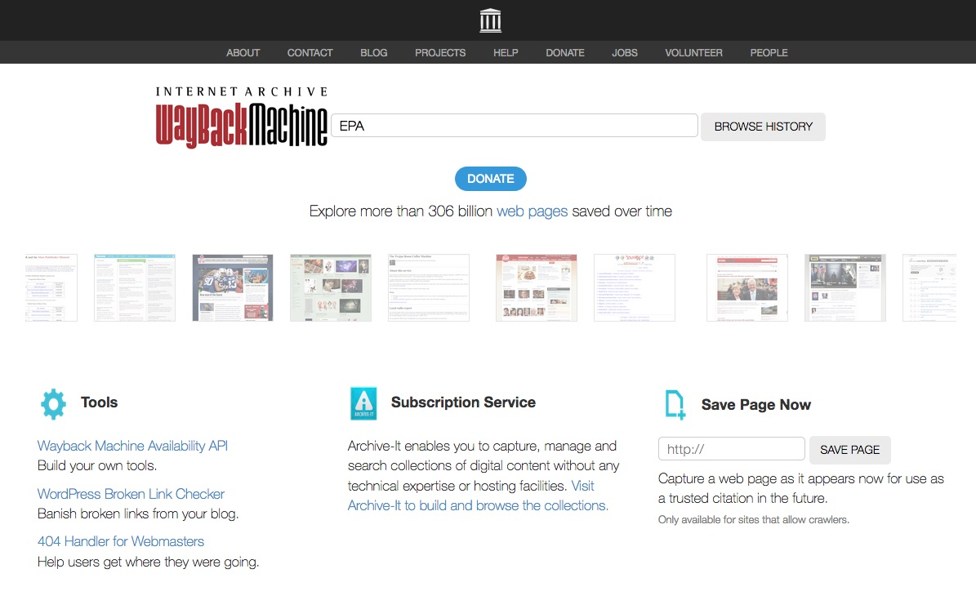

Slide 15
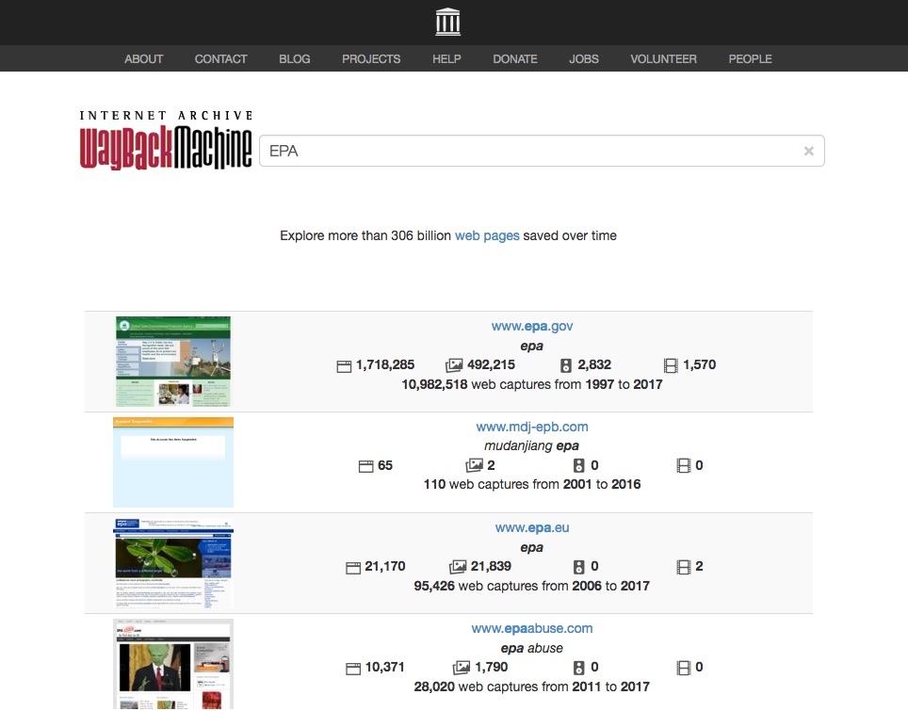

Slide 16
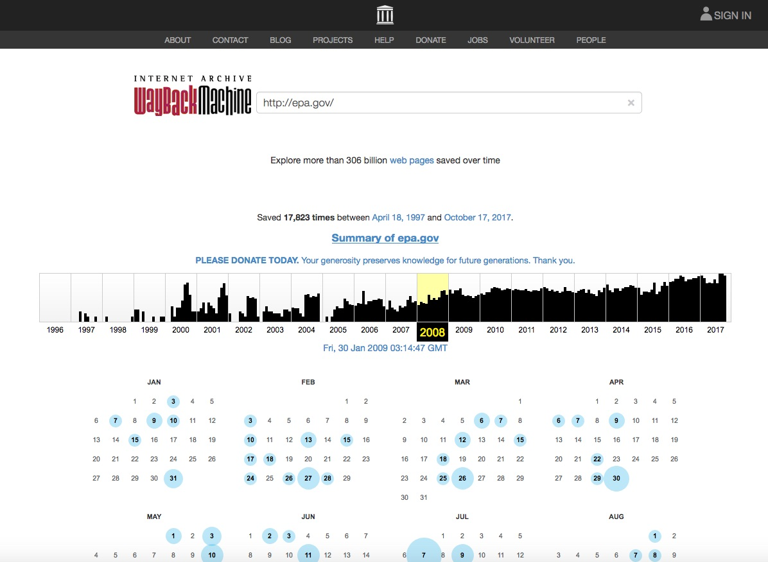

Slide 17
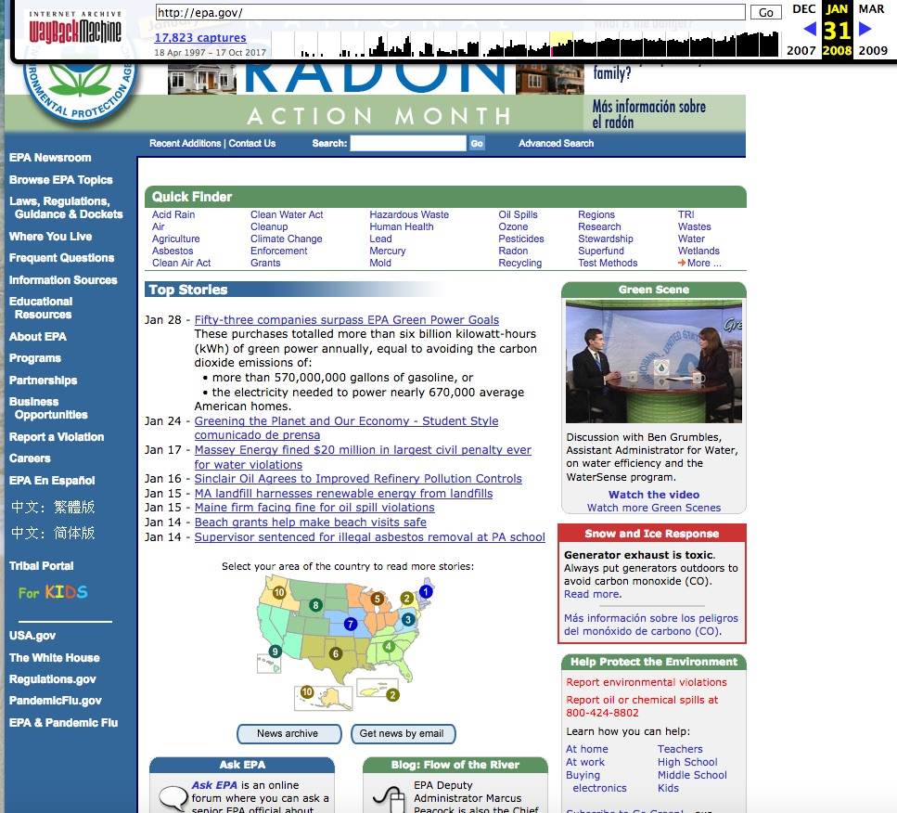

Slide 18
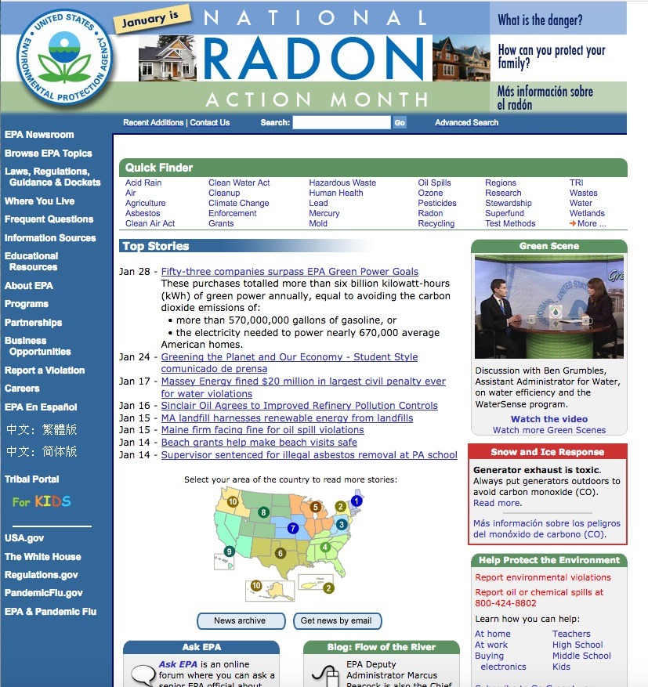

Slide 19
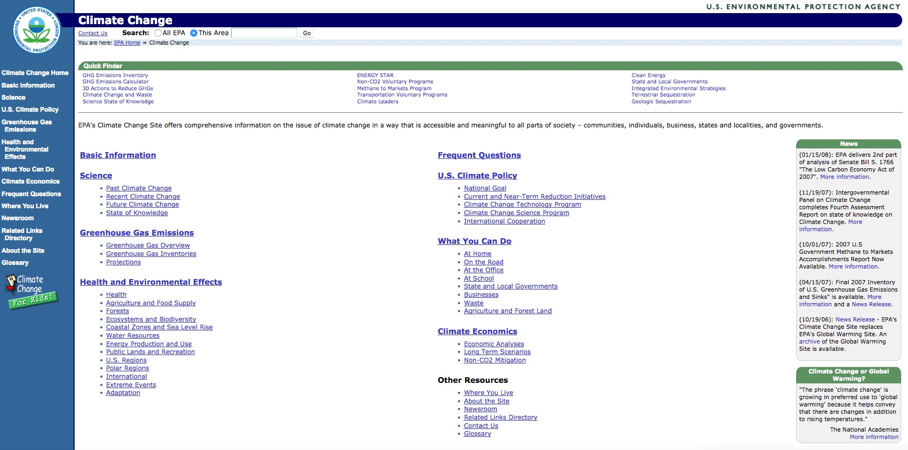

Slide 20
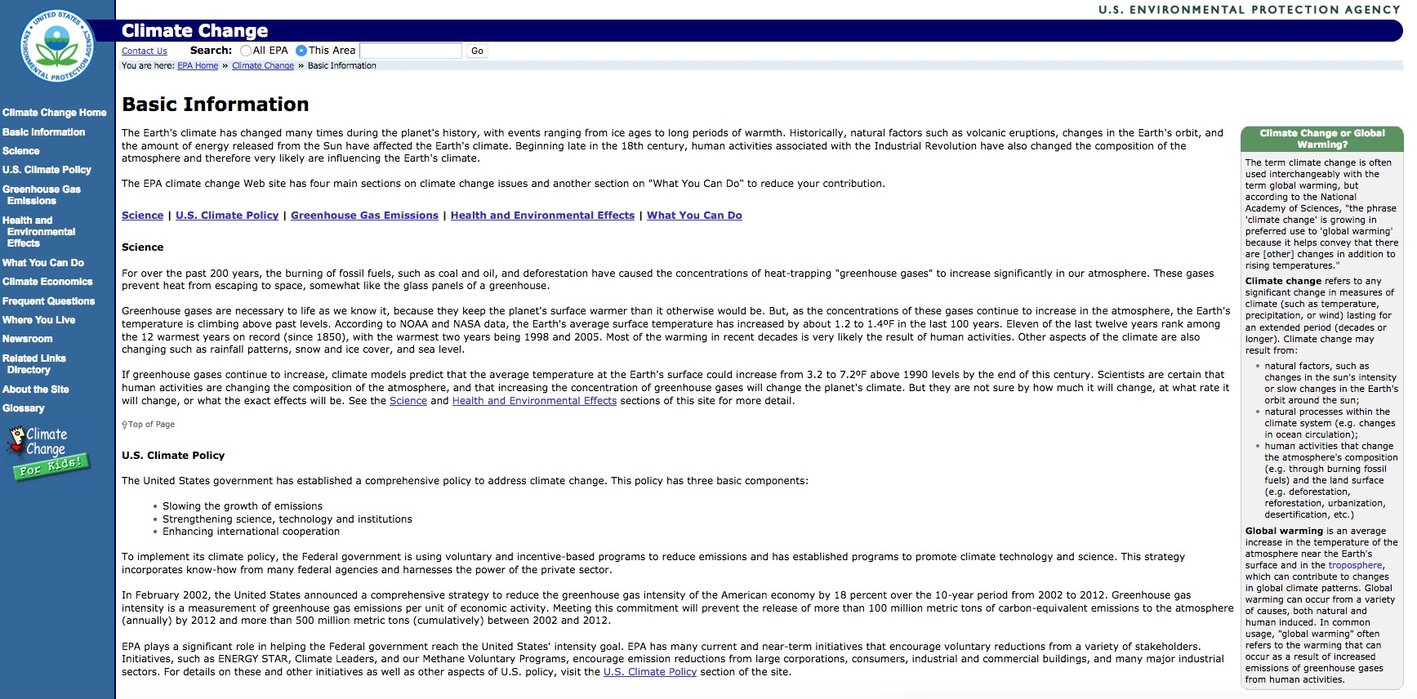

Slide 21
Side-by-side comparison

Slide 22
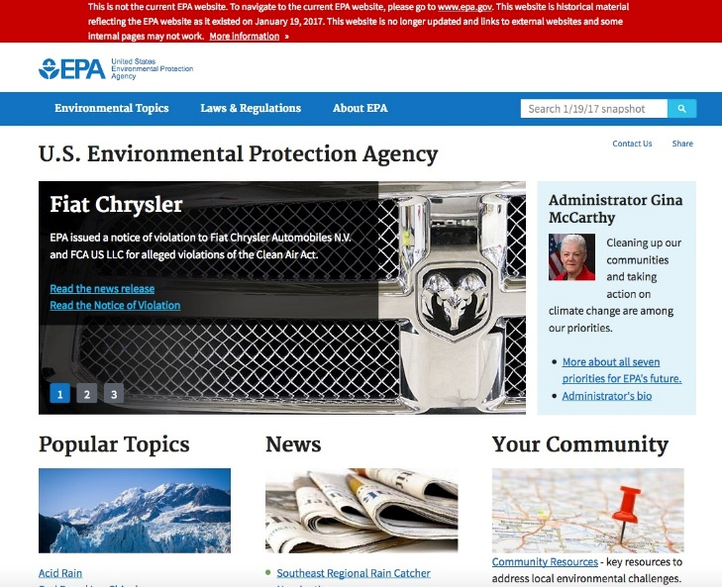
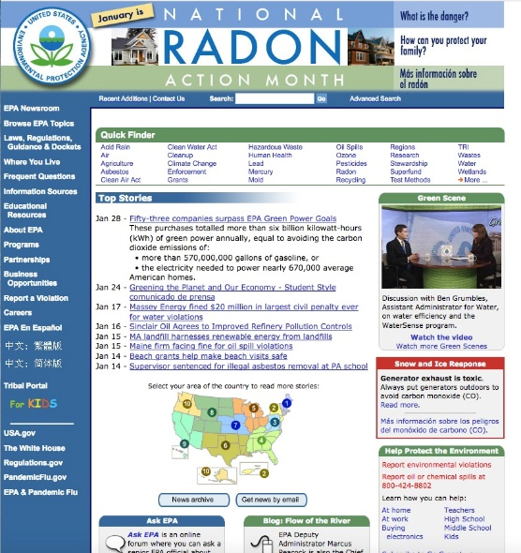
How many times is “climate change” mentioned on the homepage?
Trump
Obama
Bush
none
3 times
1 time

Slide 23
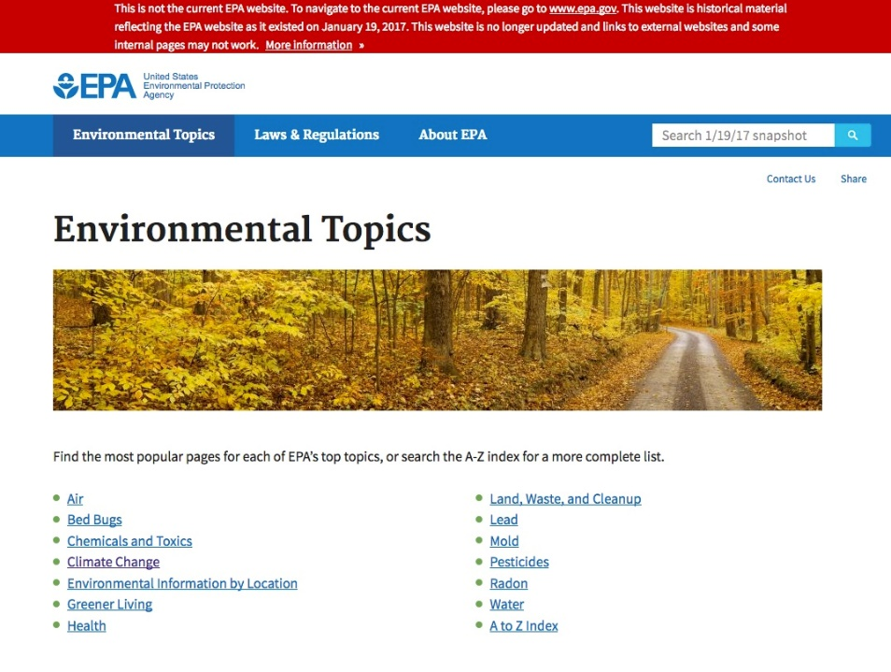
Trump
Obama
Notes:
https://www.epa.gov/environmental-topics
10/17/2017

Slide 24
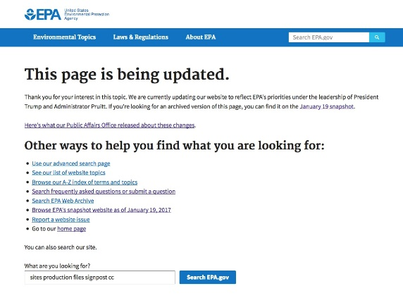
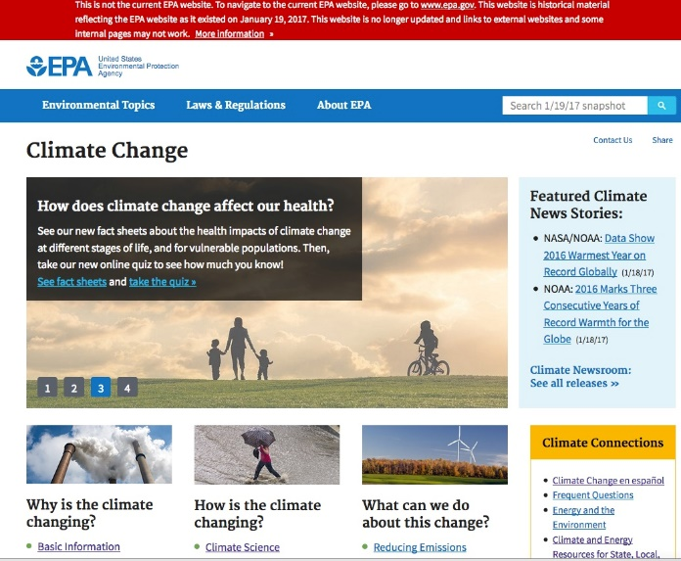
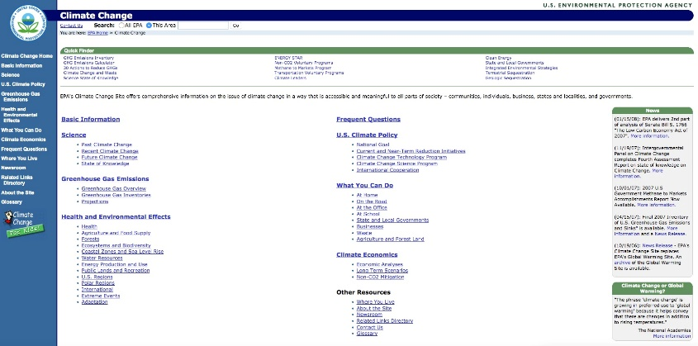
The EPA has had a “basic” climate change webpage for over 20 years.
Trump
Obama
Bush

Slide 25
http://libguides.lmu.edu/ENVS398
Tools
DataRefuge
End of Term Web Archive
Internet Archive - Wayback Machine
Read more...
EPA website removes climate science site from public view after two decades
Harvesting Government History, One Web Page at a Time
The Environmental Data & Governance Initiative (EDGI)
PROJECT_ARCC
Climate Mirror

Slide 26
http://libguides.lmu.edu/environmentalscience

Slide 27
