Slide 1
Fighting Fake News: Preparing Learners from Diverse Backgrounds to Discover their Inner Truth Seeking Powers Presented by Michelle Keba, MSIS Palm Beach Atlantic University

Slide 2
Palm Beach Atlantic University
Interdenominational Christian University founded in 1968
Located in West Palm Beach, FL
3,843 students (2,272 traditional undergraduate day)
64% female, 36% male

Slide 3
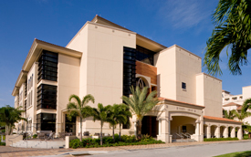
Information Literacy Threshold Concepts
Authority is Constructed & Contextual
Information Creation as a Process
Information Has Value
Research as Inquiry
Scholarship as Conversation
Searching as Strategic Exploration

Slide 4
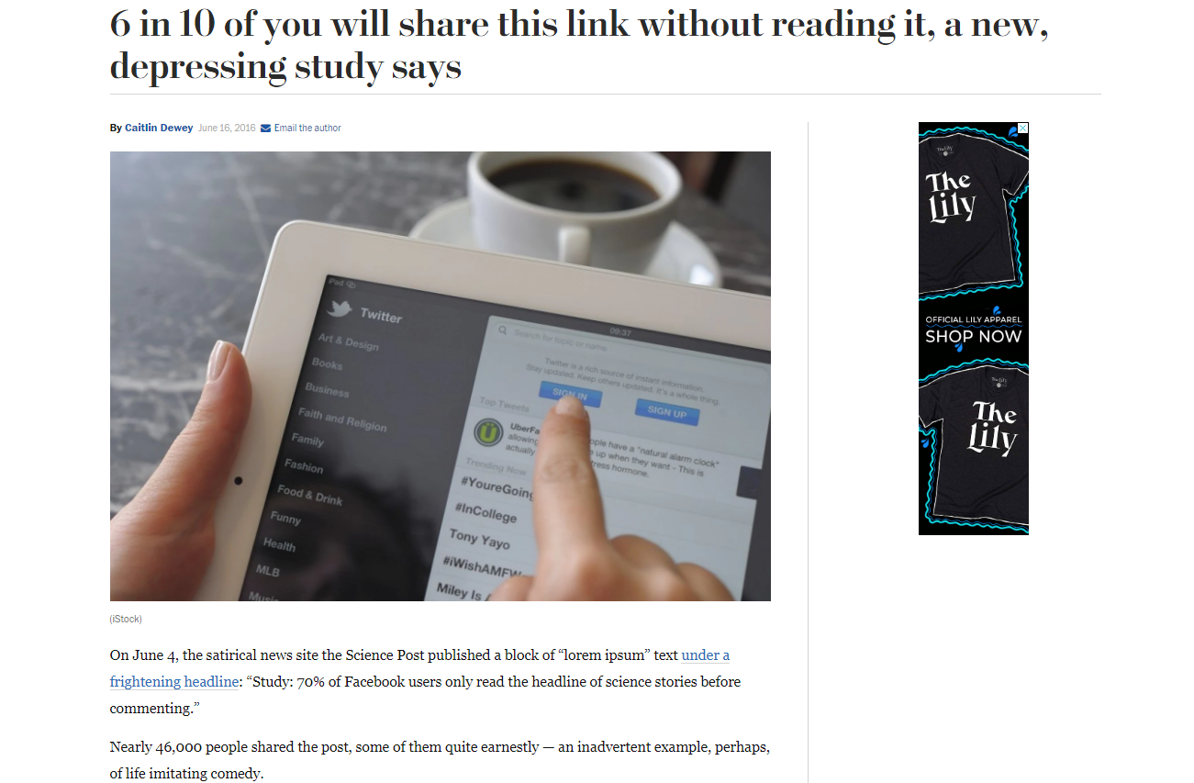

Slide 5
Real or Fake?
Obama Finishes Deal to Get Every American a Free Parrot

Slide 6
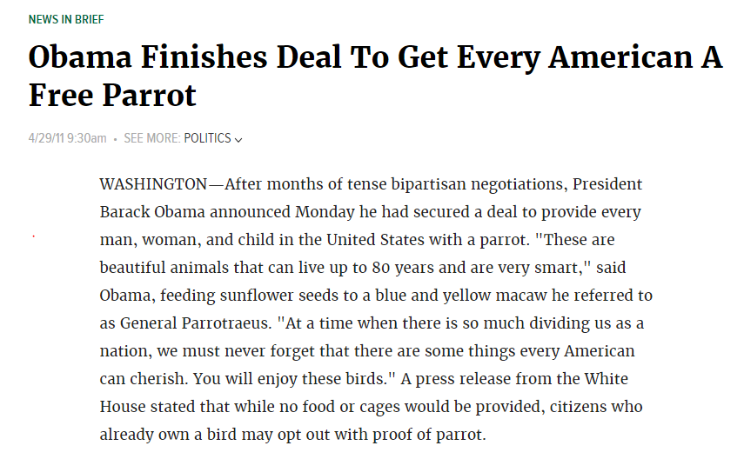
FAKE!
Notes:
Topics to Discuss Here – Satirical News Sites (participants may not have heard of sites like the Onion)

Slide 7
Real or Fake?
11-year-old girl catches piranha relative in Oklahoma lake

Slide 8
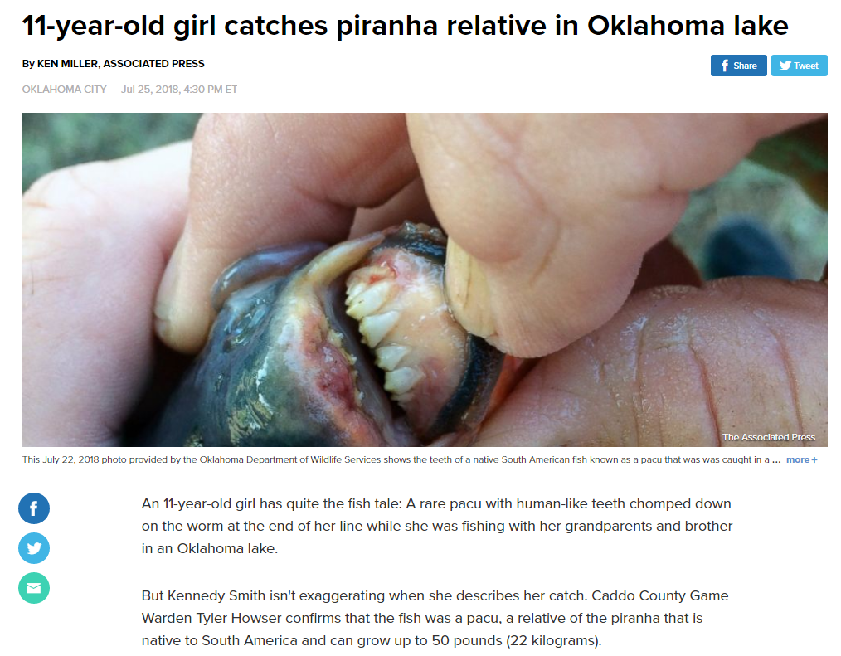
REAL

Slide 9
Real or Fake?
Flight Crew Takes A Knee And Walks Off, Leaving New Orleans Saints Stranded on Runway

Slide 10
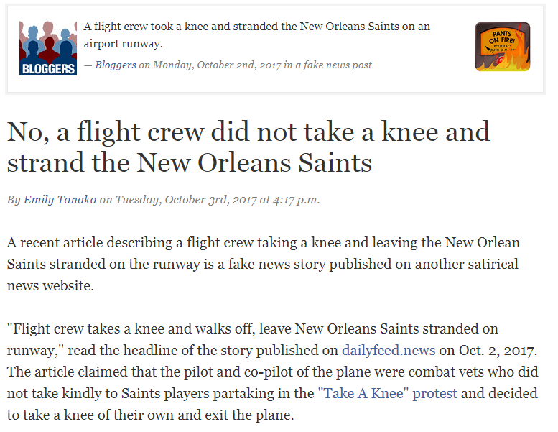
FAKE!
Notes:
Possible Topics to Discuss Here :
-motivation (why do people post fake news stories)
-how should you respond when you see someone posting a fake news story?

Slide 11
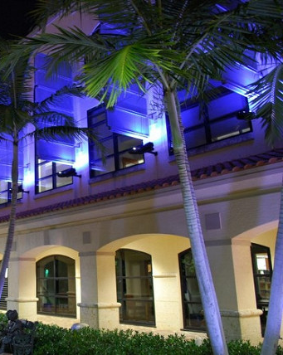
Real or Fake?
Donald Trump Protester Speaks Out: 'I Was Paid $3,500 To Protest Trump's Rally'

Slide 12
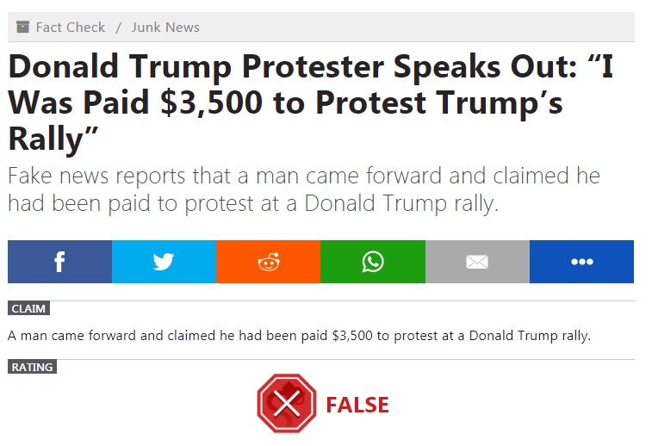
FAKE!
Notes:
Possible Topics to Discuss Here :
-motivation (why do people post fake news stories)
- Give Background info about author of this story – Paul Horner, 38, died last year, not a Trump supporter, regretted that he may have influenced election, died in 2017, made $5,000-$8,000 a month from advertising
-how can you find out if a story is true or not (visit the site and see if it admits to being satirical, Beware of URLS like abc.com.co, search Google yourself to see if any other news papers are covering the story, check websites like politifact or snopes)

Slide 13
Real or Fake?
BREAKING: ‘Tens of thousands’ of fraudulent Clinton votes found in Ohio warehouse

Slide 14
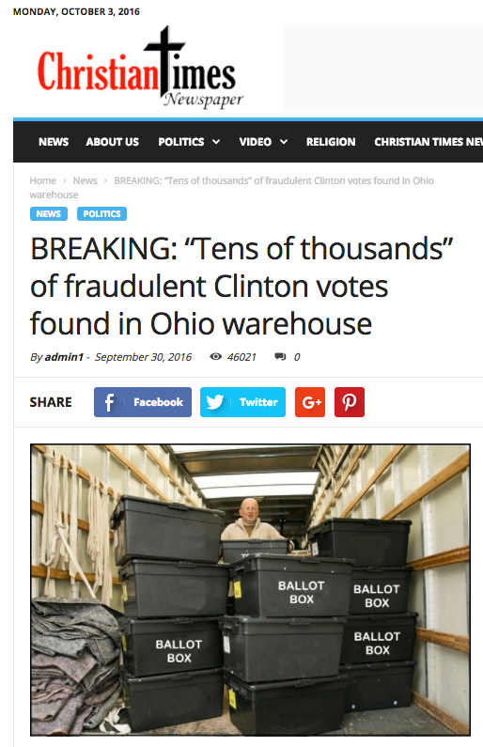
FAKE!
Notes:
Possible Topics to Discuss Here :
-motivation (why do people post fake news stories)
- Give Background info about author of this story – Cameron Harris, recent college grad, earned at least $5,000, claimed he wanted to pay off student loans, was fired from his job as a Maryland legislative aid

Slide 15
Real or Fake?
A Texas Woman ‘Voted Like a U.S. Citizen.’ Only She Wasn’t.

Slide 16
REAL

Slide 17
Real or Fake?
FBI Agent Suspected In Hillary Email Leaks Found Dead In Apparent Murder-Suicide

Slide 18
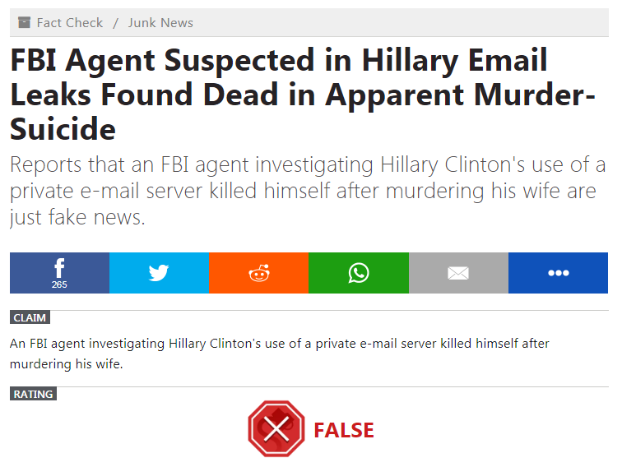
FAKE!
Notes:
Shared on Facebook over half a million times
Publiushed on Denverguardian.com
Jestin Coler, 40 year old with a wife and two kids, owns a company called Disinformedia which ran (runs?) many fake news websites including nationalreport.net
Made $10,000-30,000 per month
Wants to show how quickly fake news spreads

Slide 19
Real or Fake?
Whoopi Goldberg says that Navy SEAL Widow was “Looking for Attention”

Slide 20
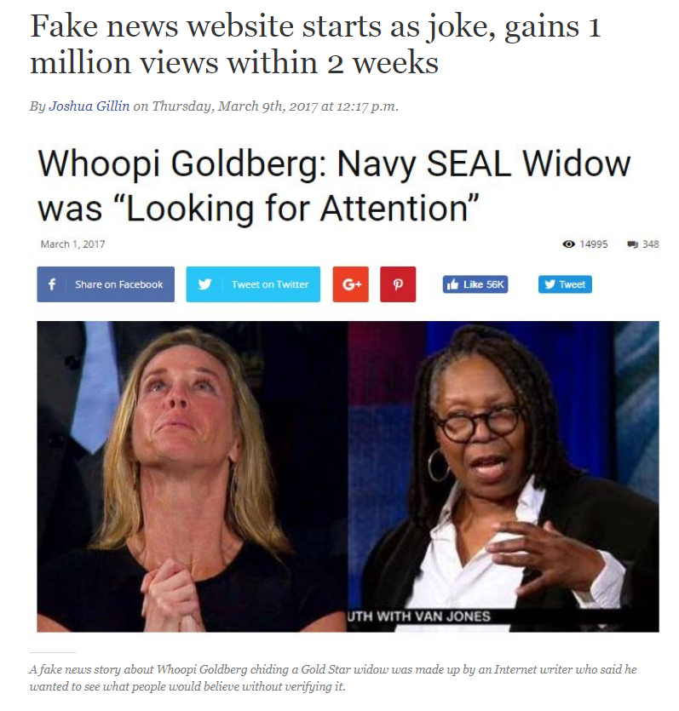
FAKE!
Notes:
Possible Topics to Discuss Here :
-emotional damage (published as a “joke” by James McDaniel, 28, at undergroundnewsreport.com, Whoopi Goldberg threatened to sue)

Slide 21
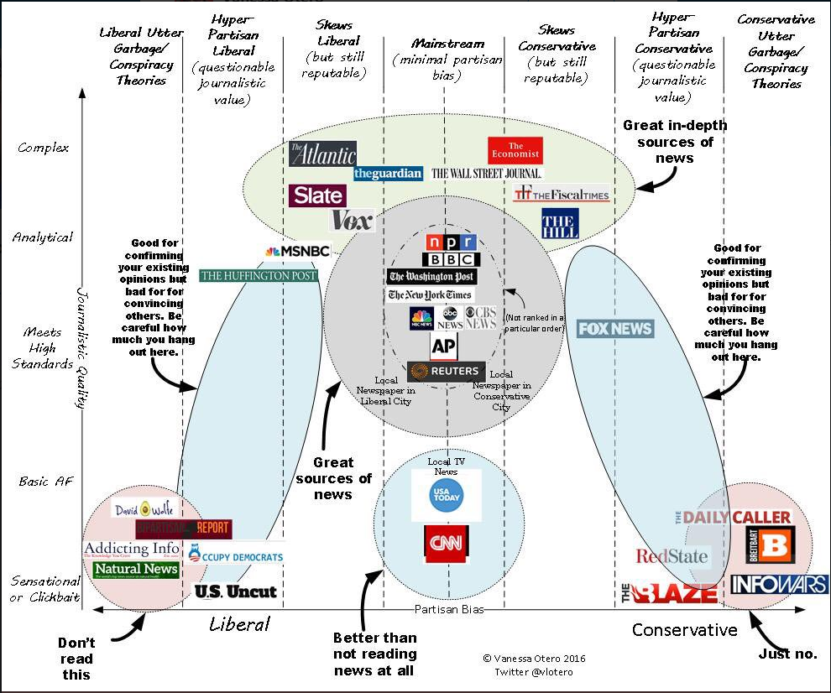
Notes:
What do you think of Vanessa Otero’s news chart? Is it accurate? Is it easy to label new sources as liberal or conservative?
https://twitter.com/vlotero/status/808696317174288387

Slide 22
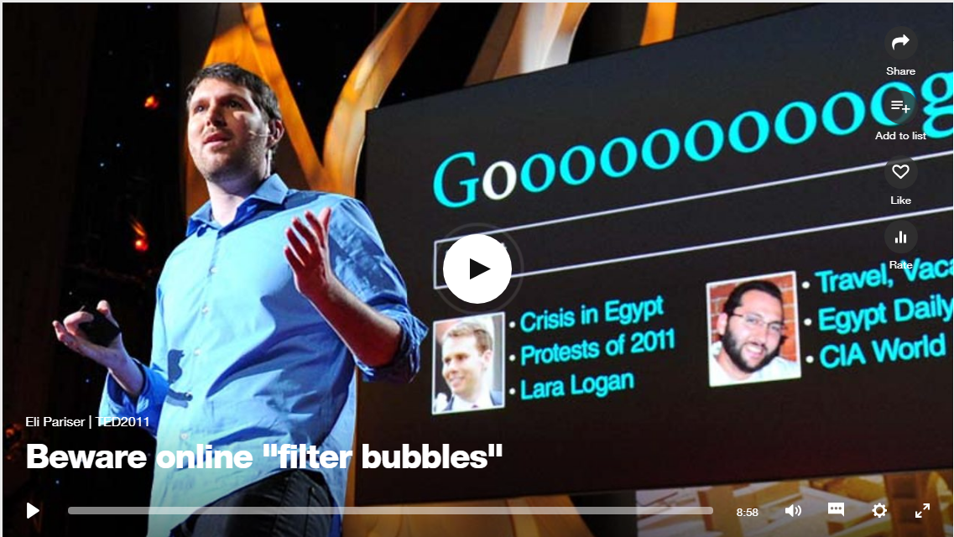
TED Talk – Beware Online Filter Bubbles

Slide 23
Questions?
My contact information:
Email: michelle_keba@pba.edu
Phone: 561-803-2230
Additional resources:
https://guides.monmouth.edu/media_literacy
http://tinyurl.com/FakeNewsLibGuide
https://sites.google.com/umich.edu/library-fake-news/home
https://connection.sagepub.com/blog/sage-connection/2017/09/21/how-librarians-can-help-fight-the-fake-news-epidemic/

