Slide 1
Legal Research
TCMP 571 A: Legal Urbanism
University of Washington Tacoma
April 24, 2019

Slide 2
Assignment 1 Reflection/Discussion
What is your research topic?
What are some possible legal resources?
Did anyone find any great resources that they would like to share?

Slide 3
Review: Three Branches
Makes law by enacting Statutes
Legislative
Branch
Enforces laws through regulations and other administrative action
Executive
Branch
Judicial
Branch
Interprets the law, and creates primary law through judicial opinions

Slide 4
Primary Law
Statutes: written law passed by legislative body
Regulatory Law: law promulgated by executive branch agency
Case Law: law based on judicial opinions
Two Parallel Systems of Primary Law
Federal
State
Source: Beginning Legal Research :
Notes:
From the three branches we have three sources of primary authority that are Binding statements of law.

Slide 5
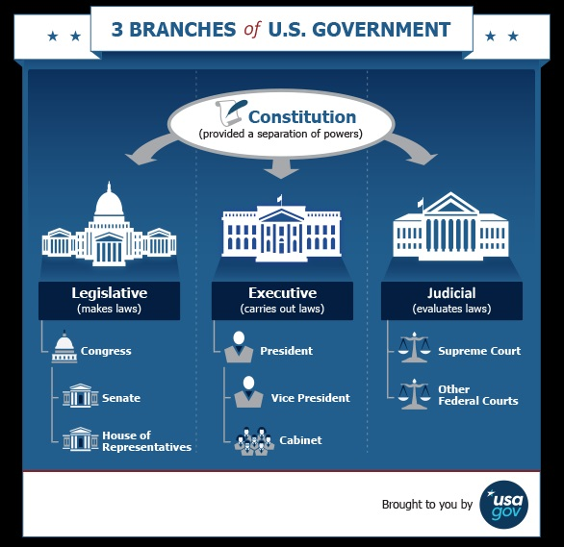

Slide 6
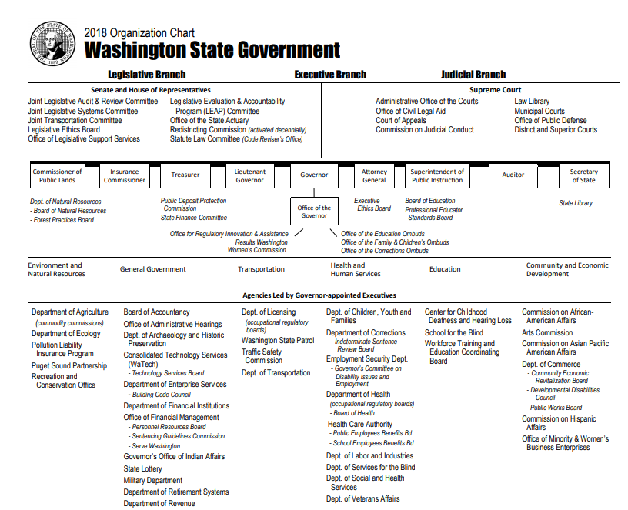

Slide 7
Local Government
Counties, cities, towns and special districts
Elected commissioners, counsel members, and mayor
Provided authority through Title 35, 35A & 36 RCW (Washington State)
Allocate local budgets, protect public health, provide human services, conduct elections, responsible for superior and district courts (county level)

Slide 8
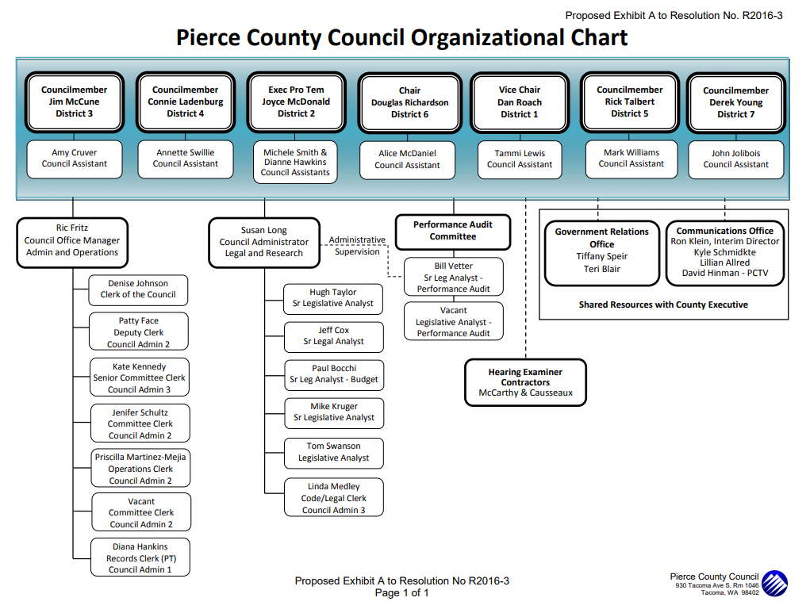

Slide 9
Federal Level v. State Level
U.S. Supreme Court
Local and State Cases In Washington
Federal Cases
Appellate Courts:
WA State Supreme Court
U.S. Court of Appeals
WA State Court of Appeals
Trial Courts :
U.S. District Courts
Superior Courts
U.S. Court of Claims
U.S. Court of International Trade
District Courts with Small Claims
Municipal Courts
Source: courts.wa.gov
Notes:
Two parallel system fo primary law - Systems are hierarchical

Slide 10
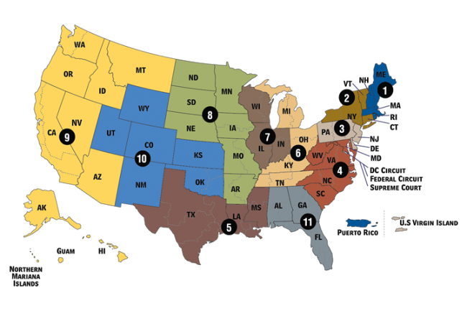
Thirteen Appellate Courts
Source: uscourts.gov

Slide 11
Research Strategy
Conduct preliminary analysis of research need (jurisdiction, keywords, time period)
Consult secondary sources (law reviews, encyclopedias, Nutshell series, books, articles) review citations and note possible keywords and topics
Consult commercial databases (Nexis Uni, Hein Online), which provide annotations including summaries and core terms

Slide 12
Exercise
Spend about 5 minutes working through the legal research preliminary analysis worksheet.
Get into groups of 2-3 people. Discuss your individual topics, and offer each other possible sources to explore (5-10 minutes).

Slide 13
Government Portals
Notes:
Case law is primary law created by judicial opinions in the course of resolving disputes. It is the written resolution of the issues, written by a judge or a panel of judges. It is not a jury verdict. Juries decide facts; judges decide law. The word case is often used interchangeably with opinion or decision.

Slide 14
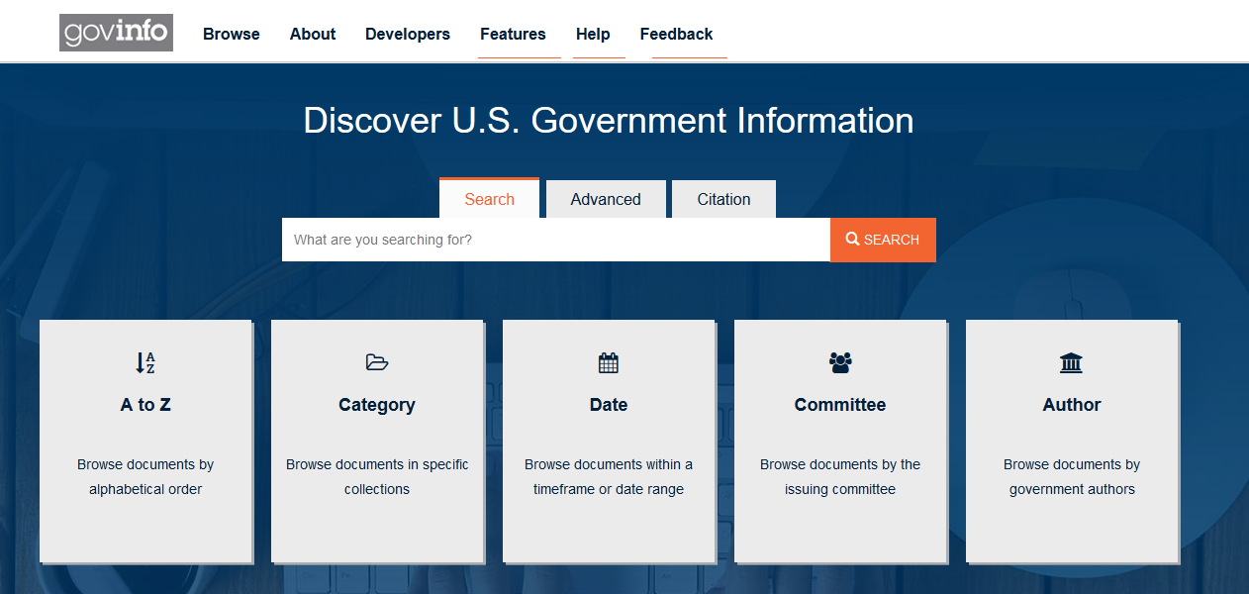
United States Court Opinions (govinfo)
Notes:
govinfo is a service of the United States Government Publishing Office (GPO), which is a Federal agency in the legislative branch.
govinfo provides free public access to official publications from all three branches of the Federal Government.

Slide 15
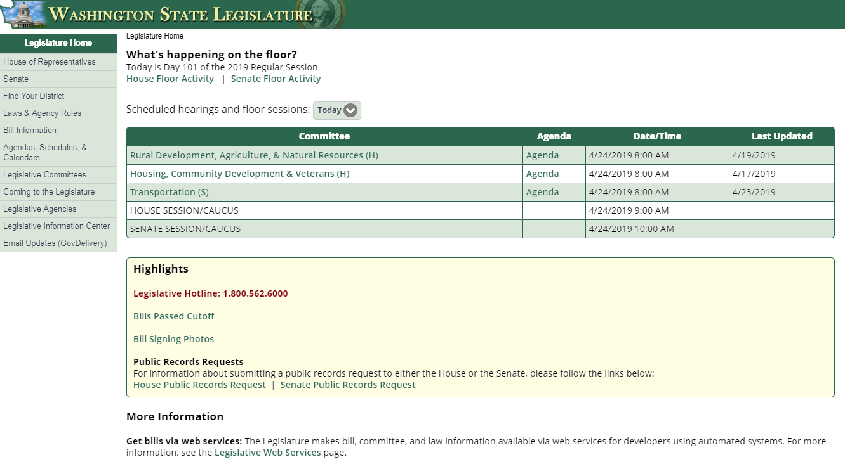
Washington State Legislature
Notes:
RCW and WAC

Slide 16
What is the purpose of case law?
To determine the constitutionality of statutes
To interpret statutes
To decide cases in the absence of statutes
Source: Case Law, Citators, & Digests

Slide 17
Evaluating Case Law
On Point
Binding authority
Recent
Leading case
Source: Case Law, Citators, & Digests

Slide 18
Elements of a Supreme Court Citation
ZAFIRO et al. v. UNITED STATES 506 U.S. 534 (1993)
Zafiro et al v. United States
(1993)
506
U.S.
534
Case Name
Volume
Number
Reporter
Starting Page Number
Year of Decision

Slide 19
Parallel Citation
ZAFIRO et al. v. UNITED STATES 113 S.Ct 933 (1993)
Zafiro et al v. United States
(1993)
113
S.Ct
933
Case Name
Volume
Number
Reporter
Starting Page Number
Year of Decision
West’s U.S. Supreme Court Cases

Slide 20
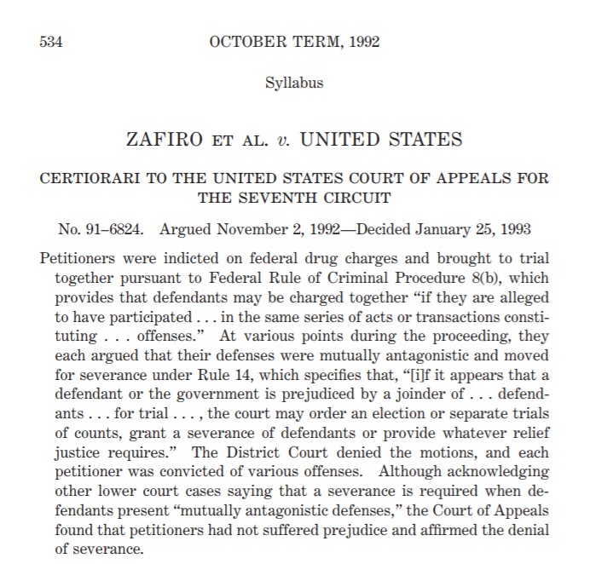
SupremeCourt.gov

Slide 21
Google Scholar
US federal district, appellate, tax and bankruptcy courts since 1923 and US Supreme Court cases since 1791. It is the most comprehensive free source of federal district court opinions.

Slide 22
Free Sites for Case Finding (Guide)
U.S. Supreme Court
U.S. Circuit Courts of Appeals and States
U.S. District Courts
U.S. Supreme Court Official Site
Cornell Legal Information Institute
FindLaw
Justia
Federal and State Court websites
FindLaw
Justia
Public Library of Law
Google Scholar
State Court Dockets
Court Websites
News Sources
Justia
Google Scholar

Slide 23
Elements of WA State Supreme Court Citation
State v. O’Dell
183 Wn.2d 680 (2015)
State v. O'Dell
Wn.2d
(2015)
183
680
Case Name
Volume
Number
Reporter
Starting Page Number
Year of Decision
Notes:
Washington Reports, 2d Series,
Washington Appellate Reports (Wash.App.2d)

Slide 24
Free Sites for Case Finding in Washington
WA Supreme Court & WA Court of Appeals
Washington State Judicial Opinions Website
Google Scholar
Court Listener
FindLaw

Slide 25
Questions?
Notes:
Case law is primary law created by judicial opinions in the course of resolving disputes. It is the written resolution of the issues, written by a judge or a panel of judges. It is not a jury verdict. Juries decide facts; judges decide law. The word case is often used interchangeably with opinion or decision.

Slide 26
Additional Resources
Law – UW Tacoma Research Guide
WA Opinions – UW Research Guide
Video – Introduction to Case Law Research
Video –How to Read a Case

