Slide 1
Digital Maps
With HistoryPin

Slide 2
Class today
“Mapping Los Angeles Project: HistoryPin Collection”
Learn about how to create a digital map for your group in HistoryPin.
Understand how to brainstorm and find pins.
Analyze and describe primary sources.
Cite copyrighted material properly.
Have fun with Literary LA!

Slide 3
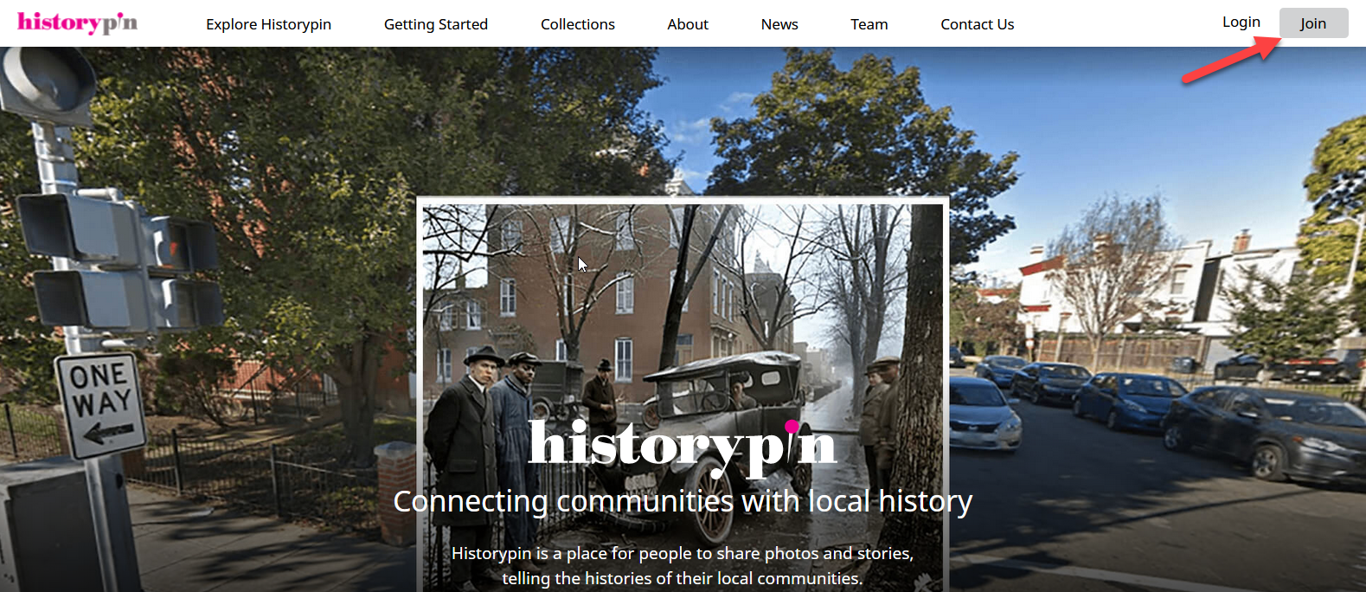

Slide 4
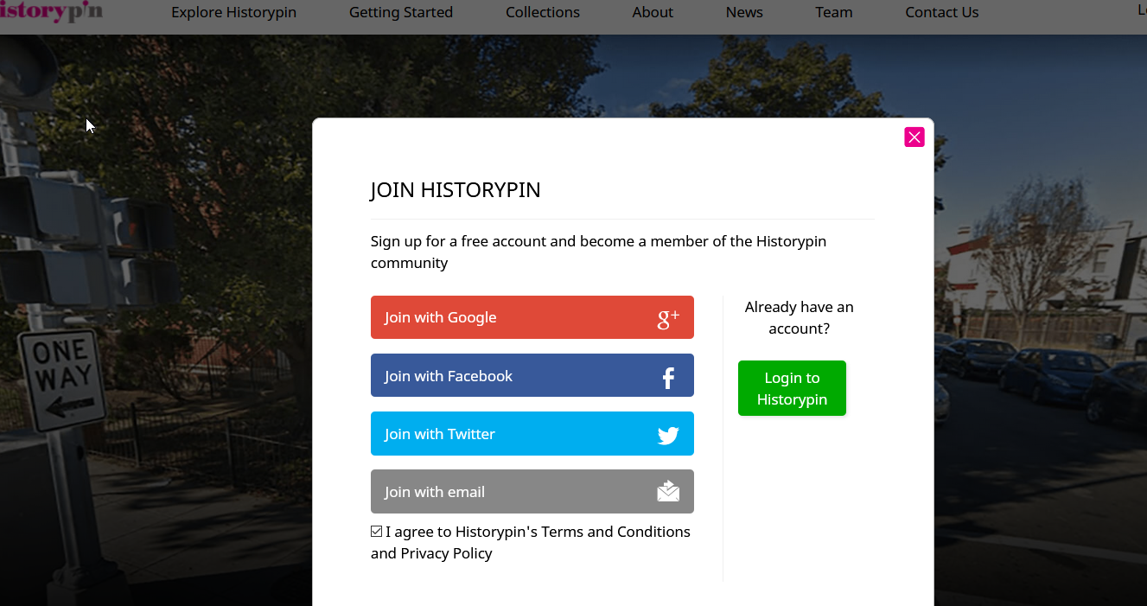

Slide 5
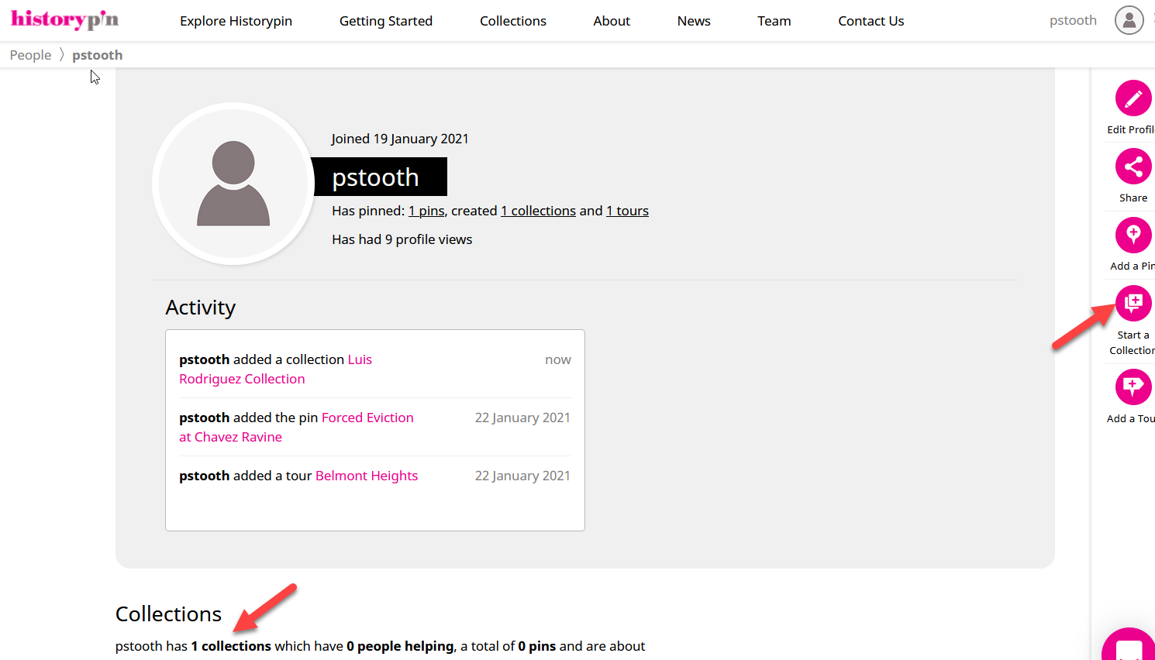
One group member starts a collection

Slide 6
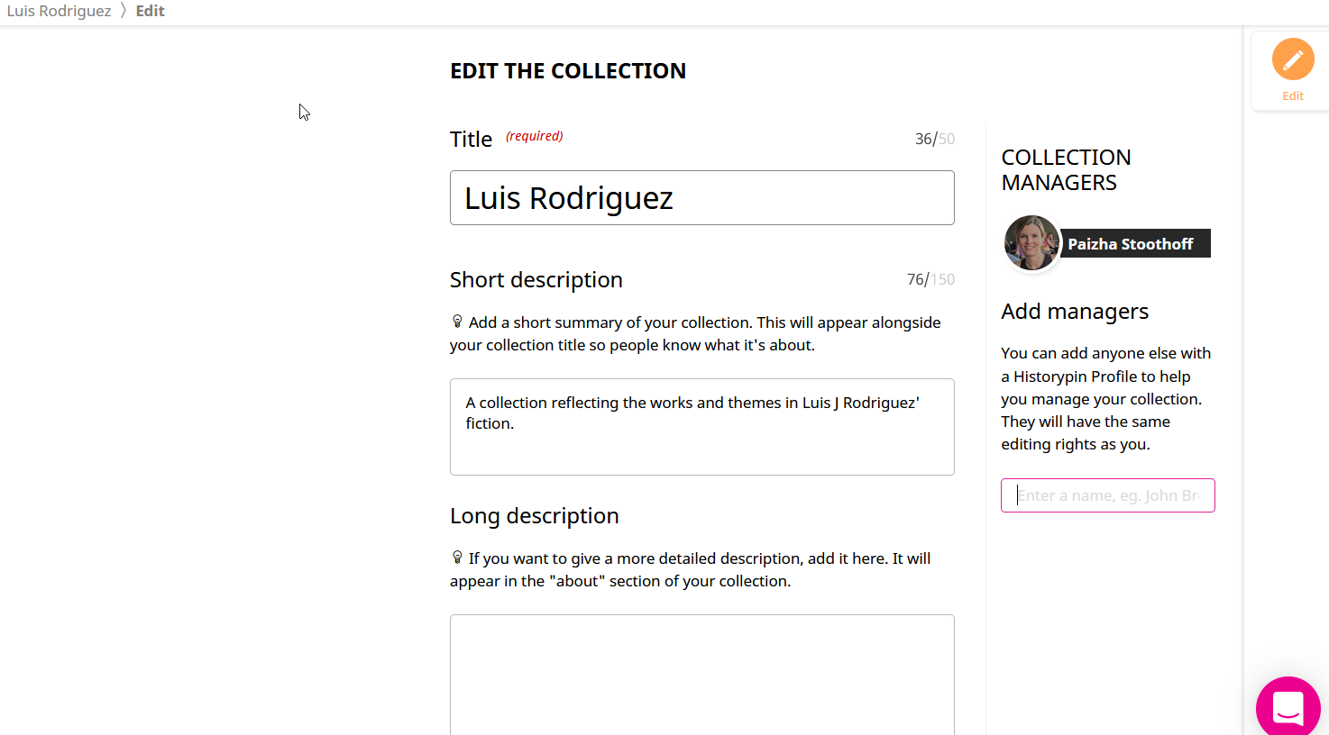
The creator adds managers. Team members must be registered.

Slide 7
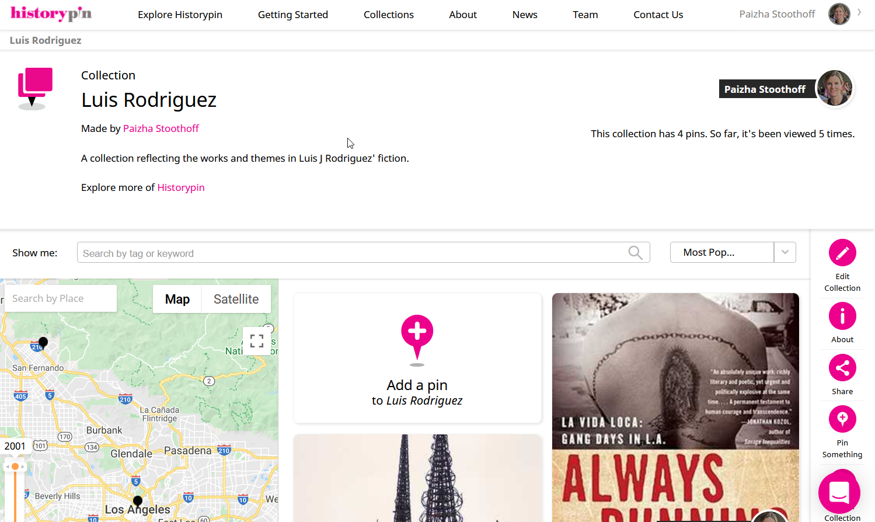

Slide 8
Why create digital maps
Tell a story
interact
Deepen your knowledge
What is important about a person, issue, or event?
Engage with others by commenting and adding your pins.
Find and interpret different kinds of sources / information.

Slide 9
Understand how to brainstorm and find pins
What kind of content should i include?
Photos / Images
Historic buildings
Public spaces
People
Art
Historical photos
Logos or signs (bookstores)
Text
Important quotes (from the text about a place)
Video or sound
Video clips (YouTube, etc)
.mp4 files from your computer
Oral history recordings

Slide 10
Where can i find images / info?
Open Web
Creative Commons Images
Library Databases
Biography
Quick Facts
ArtSTOR
Special Collections & Archives
Next!
Using HistoryPin Guide: https://libguides.calstatela.edu/c.php?g=1116156

Slide 11
SPecial Collections & Archives
Archives
Documents, Photographs, Scrapbooks, Posters
Unpublished
Library
Rare Books
Published
Museum
Artifacts
objects

Slide 12
Primary Sources
First-hand evidence
Accounts by participants or observers
Direct Experience

Slide 13
Special Collections & Archives
https://www.calstatela.edu/specialcollections

Slide 14
PRimary Source ANalysis
Observe
Explain
Infer
Wonder
What do you observe? Consider the images, people, objects, activities, actions, words, phrases, facts, and numbers
What is the meaning of the objects, words, symbols, etc.?
What sentiment do you think the author is trying to convey through the source?
What about the source makes you curious? What questions still remain?

Slide 15
Activity:
HistoryPin Luis J. Rodriguez Collection
What else might you want to add to the Collection?

Slide 16
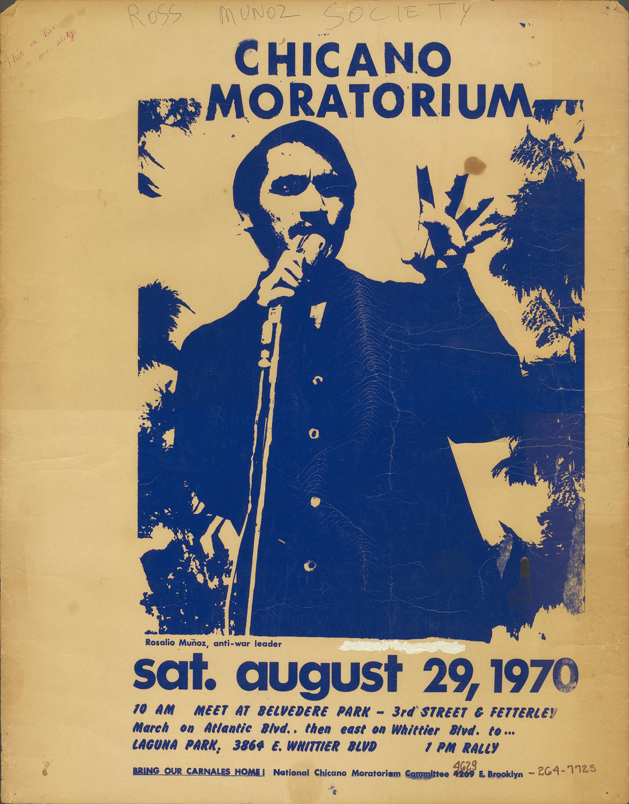
Meet the Primary Source
Observe
Explain
Infer
Wonder

Slide 17
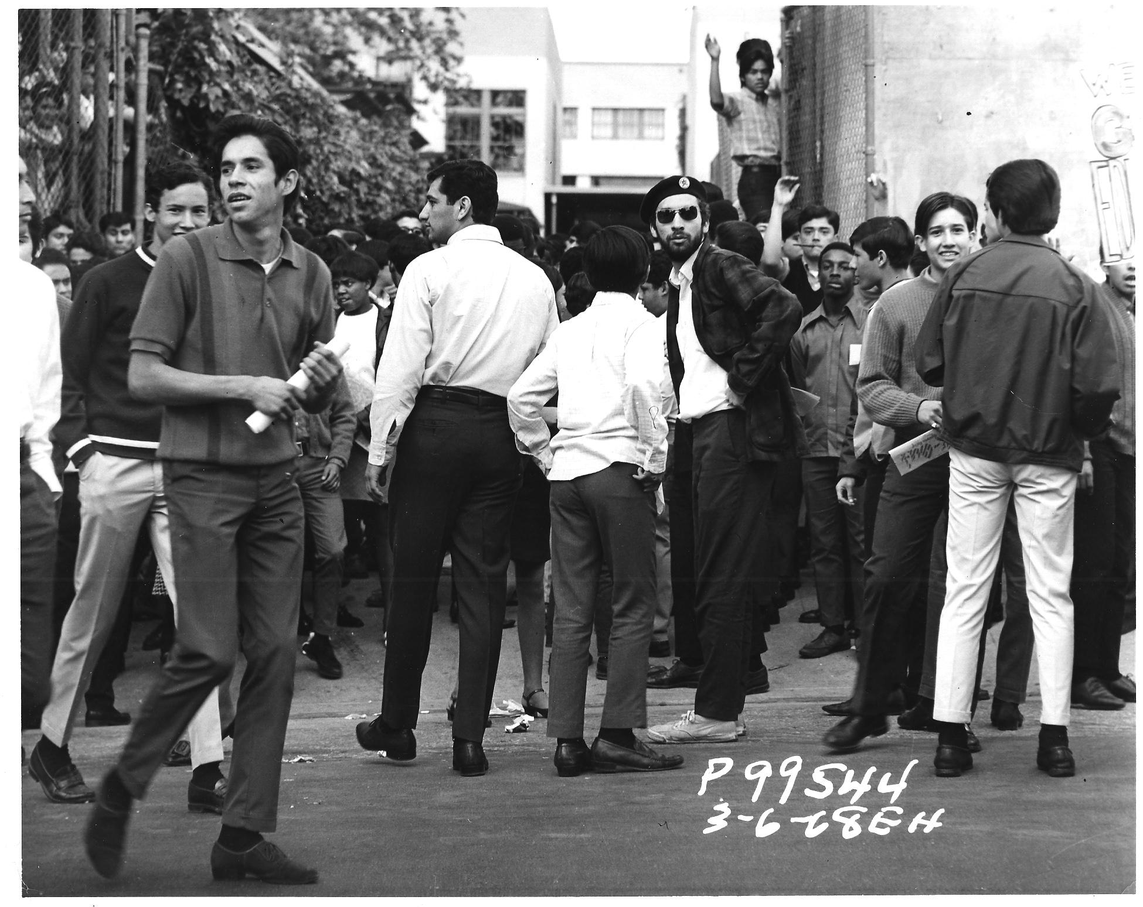
Meet the Primary Source
Observe
Explain
Infer
Wonder

Slide 18
How to cite pins properly
Open Web (Creative Commons License)
Creative Commons Images
Library Databases (copyrighted material)
Biography
Quick Facts
ArtSTOR
Special Collections & Archives (copyrighted material)

Slide 19
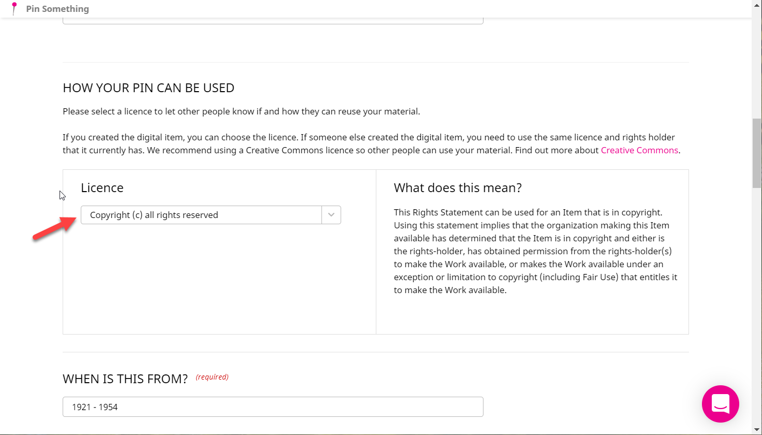

Slide 20
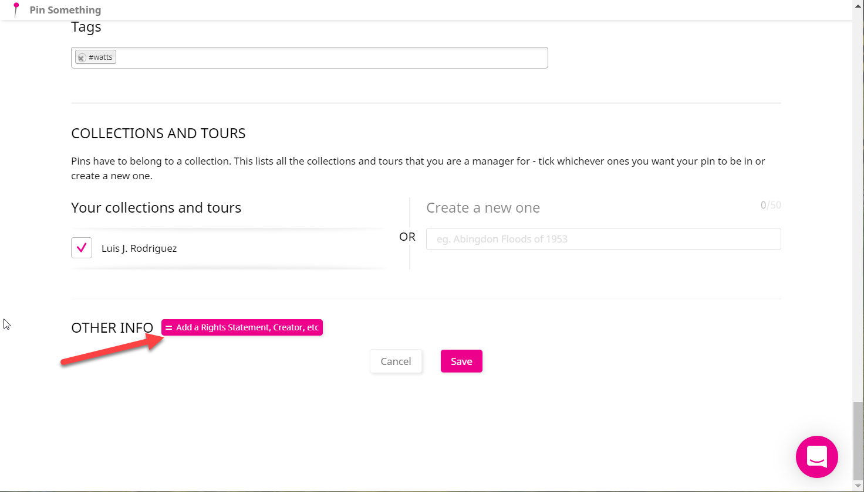

Slide 21
