Slide 1
Scientific research in popular sources: Comparing and contrasting delivery of information
Janelle Bitter, Librarian, Raritan Valley Community College
C² Summit for Pedagogical Advancements in STEM
October 18, 2019
Notes:
Classroom activity for demonstrating and discussing how popular and scholarly sources are different, thinking about the way each is created
Talking about why this is the case – intended audience, purpose, type of information communicated
Explicit about the point of the activity

Slide 2
Agenda
Learning outcomes for students
Activity:
Materials needed
Set-up
Process
Conclusion
Example
Optional add-ons

Slide 3
Learning outcomes
Students will…
Describe the information creation process for popular and scholarly sources
Compare and contrast the type of information disseminated by each
Explain the ways in which authority and accuracy are contingent upon information need
Notes:
What they will be doing during activity

Slide 4
Learning outcomes
Therefore, students will…
Evaluate the accuracy and authority of a source based on discipline and information need
Recognize and select appropriate resources for academic research
Notes:
What they will take away from the activity to use for future research
Helps me in teaching if I remember what the point is! Info Lit concepts are often higher level

Slide 5
Activity
1 scholarly article
1 news article reporting on the same research
Attached worksheet
Post-it notes or an online “bulletin board” program like Padlet*
(Optional) For digital version, online platform like LibGuides (ask your librarian!)
Materials needed
*Internet Explorer not supported

Slide 6
Scientific Research in Popular Sources
‘a’ questions can be answered by reading the article or with a quick Internet search
‘b’ questions require analysis of the article based on your experiences and knowledge
(Did the popular article accurately represent the scholarly article? Why do you think this is?)
 | Popular article | Scholarly article
a) Author info b) How do we know this author is authoritative?
a) Publisher info b) How do we know this publication is authoritative?
a) Citations/references (can be formal or informal) b) How is accuracy demonstrated for this type of source?
a) Main point/research question b) What is the purpose of this type of source?
a) Content (language, images, format) b) Who is the intended audience of this type of source?
a) Date of publication b) How long does it take to create this type of source (research, writing, editing)?

Slide 7
Activity
Print 1 copy of each article for each student -OR-
Link/embed articles in Padlet or a LibGuide
Print 1 worksheet for each student
Clear a wall for Post-it Notes -OR-
Prepare to project Padlet
(if using online tools, each student will need a computer)
Set-up

Slide 8
Activity
Think—Pair—Share
Each student reads/skims both articles
Could be done in advance
Students get started on worksheet alone, answering ‘a’ questions
With partner/neighbor, work on ‘b’ questions
Students share answers using Post-its or Padlet
Class discussion
Process

Slide 9
Activity
Class discusses how observable answers (‘a’ questions) helped them think critically to discover answers to more complex questions (‘b’ questions)
Class debates answers to ‘b’ questions and defends their decisions
Class analyzes whether popular article was accurate representation and why this may be
Prompt students to think/talk about how this will affect their own research
Conclusion

Slide 10
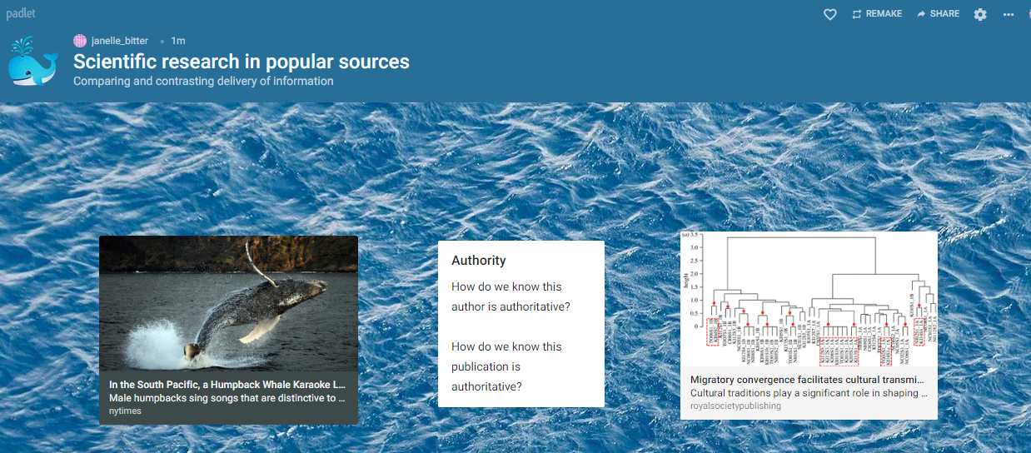
Example -

Slide 11
Optional add-ons
Focus on the privilege of accessing scholarly research:
Find a scholarly article only available behind a paywall/in a library database and an open access scholarly article
Discuss these creation processes and the effect they have
What happens to those who lack this privilege?
What does this mean for authority/credibility?

Slide 12
Example
Whale article (Royal Society Open Science)
Water vapor on planet:
Water detected in atmosphere of potentially habitable super-Earth (CNN)
Water vapour in the atmosphere of the habitable-zone eight-Earth-mass planet K2-18 b (Nature Astronomy)
Notes:
RVCC does not have access to this article, even through our paid subscriptions

Slide 13
Optional add-ons
Focus on exaggerated language in popular articles:
Find an article whose non-expert language grabs readers’ attention
Discuss why this may be done and the effect it has
What does the “value” of information mean in different contexts?
Confirmation bias—seeking out info that agrees with your worldview
Notes:
Subtle – more examples in social sciences
Why? = to be easier to understand, or for attention?
Value = $, persuasion; or education

Slide 14
Examples
Planetary discovery
Giant exoplanet found around tiny star shouldn't even exist, astronomers say (CNN)
A giant exoplanet orbiting a very-low-mass star challenges planet formation models (Science)
Origins of life
Building blocks of life may have come from deep space: 'Key to unraveling fundamental questions for humankind‘ (Fox News)
Nucleobase synthesis in interstellar ices (Nature Communications)
Notes:
Maybe these titles are a good thing? Get people to read about something they may otherwise decide is above their heads,

Slide 15
Optional add-ons
Focus on the process of research
Students must find articles used for discussion or must find scholarly article given news article (could be done in advance)
Discuss different techniques needed for each (location, keywords, planning/effort)
Were scholarly articles always linked from news article?
What challenges did you face?
Notes:
Are scholarly articles free online? Do links work or are they broken/outdated?

Slide 16
Example
Decline in wild bird population
Where Have the Wild Birds Gone? 3 Billion Fewer Than 1970 (AP/US News)
Decline of the North American avifauna (Science)
Notes:
Went to Science website, searched, narrowed by date, had to go through news article and find link to click to scholarly article
Have in print, but database subscription is delayed by 6 years (JSTOR), others are 1983-2005

Slide 17
Thank you! Questions?
Janelle Bitter
Librarian, RVCC
janelle.bitter@raritanval.edu

